Slide 1

Audit Transformations
GRA|RADC|EMS|CMS Diagnostics| AQMM
SAFe PI Planning
13 July – 15 July, 2021

Slide 2
Best Practices to follow in our “Virtual” PI Planning
(Meeting Etiquettes)
Every participant is encouraged to join the meeting with Zoom Video.
Video is Mandatory for those speaking or presenting in the PI.
Mute your mic at all times unless speaking.
Treat this meeting as if we are collocated for the One Team experience.
If you want to ask a question, follow these steps:
At the bottom of Zoom window, Click on Manage Participants option.
A panel of participants list shall open on the right pane of the window.
Click on “Raise a Hand” icon.
This is a Virtual PI due to current circumstances. Let's coordinate to collaborate and make this a successful PI event.

Slide 3
Agenda Day 1 – July 13, 2021
Start | Finish | USI Start | USI Finish | Agenda Item | Duration | Owner
7:30 AM | 7:35 AM | 5:00 PM | 5:05 PM | Welcome/ART Structure | 5 | Dharini
7:35 AM | 8:35 AM | 5:05 PM | 6:05 PM | Business Impact/Context/Roadmap | 60 | Arnold/Ben
8:35 AM | 8:45 AM | 6:05 PM | 6:15 PM | Coffee Break | 10 | ALL
8:45 AM | 9:15 AM | 6:15 PM | 6:45 PM | Release Vision - Audit Online | 30 | Lauren
9:15 AM | 9:30 AM | 6:45 PM | 7:00 PM | Release Vision - Diagnostics, DQD | 15 | Ezra/Andrew
9:30 AM | 9:45 AM | 7:00 PM | 7:15 PM | Release Vision – AQMM | 15 | Rose
9:45 AM | 10:00 AM | 7:15 PM | 7:30 PM | Release Vision – EMS, AAT | 15 | Eduardo/Rakesh/Debbie
10:00 AM | 10:05 AM | 7:30 PM | 7:35 PM | Release Vision - CMS | 5 | Prathap/Swetha
10:05 AM | 10:15 AM | 7:35 PM | 7:45 PM | Coffee Break | 10 | ALL
10:15 AM | 11:00 AM | 7:45 PM | 8:30 PM | Architecture Context | 45 | Janine/Jignesh/Anubha/ Swetha/Karthik
11:00 AM | 11:30 AM | 8:30 PM | 9:00 PM | DevOps Vision | 30 | Anindya/Gajendra
11:30 AM | 1:00 PM | 9:00 PM |  | Break for US/USI Leaves for the Day | 90
1:00 PM | 5:00 PM |  |  | Team Breakouts - Day 1 for US | 240 | Teams

Slide 4
Agenda Day 2 – July 14, 2021
Start | Finish | USI Start | USI Finish | Agenda Item | Duration | Owner
 |  | 12:00 PM | 12:15 PM | Planning Context/Set up | 15 | Anubha/Padmini
 |  | 12:15 PM | 1:30 PM | Team Breakouts – Day 1 for USI{Autocrats, Technokats, Data Dynamics, Content Fosters, Bahamas, Jamaica, Amigos, Falcon Heavy, Saturn V) | 75 | Teams
 |  | 1:30 PM | 2:30 PM | Lunch Break | 60
 |  | 2:30 PM | 4:30 PM | Team Breakouts – Day 1 for USI{Autocrats, Technokats, Data Dynamics, Content Fosters, Bahamas, Jamaica, Amigos, Falcon Heavy, Saturn V) | 120 | Teams
 |  | 4:30 PM | 5:00 PM | Coffee Break | 30
7:30 AM | 9:00 AM | 5:00 PM | 6:30 PM | Draft Plan Review [20 min per team] | 120 | Teams
9:00 AM | 9:15 AM | 6:30 PM | 6:45 PM | Coffee Break | 15
9:15 AM | 10:00 AM | 6:45 PM | 8:00 PM | Draft Plan Review [20 min per team] | 75 | Teams
10:30 AM | 12:00 PM | 8:00 PM |  | Break for US/USI Leaves for the day | 90 | Teams
12:00 PM | 4:00 PM |  |  | Team Breakouts – Day 2 for US | 240 | Teams

Slide 5
Agenda Day 3 – July15, 2021
Start | Finish | USI Start | USI Finish | Agenda Item | Duration | Owner
 |  | 12:00 AM | 12:10 PM | Planning Adjustments -USI | 10 | Padmini/Anubha
 |  | 12:10 PM | 1:30 PM | Team Breakouts – Day 2 for USI {Autocrats, Technokats, Data Dynamics, Content Fosters, Bahamas, Jamaica, Amigos, Falcon Heavy, Saturn V) | 80 | Teams
 |  | 1:30 PM | 2:30 PM | Lunch | 60
 |  | 2:30 PM | 4:30 PM | Team Breakouts – Day 2 for USI {Autocrats, Technokats, Data Dynamics, Content Fosters, Bahamas, Jamaica, Amigos, Falcon Heavy, Saturn V) | 120 | Teams
 |  | 4:30 PM | 5:00 PM | Coffee Break | 30
7:30 AM | 9:00 AM | 5:00 PM | 6:30 PM | Final Plan Review | 90 | Teams
9:00 AM | 9:15 AM | 6:30 PM | 6:45 PM | Coffee Break | 15
9:15 AM | 10:00 AM | 6:45 PM | 7:30 PM | PI Objectives & Program Risk Review | 45 | BO/TA
10:00 AM | 10:05 AM | 7:30 PM | 7:35 PM | Confidence vote | 5 | ALL
10:05 AM | 10:30 AM | 7:35 PM | 8:00 PM | PI Retro | 25 | ALL

Slide 6

Audit Transformations: Agile Release Train
Define
Implement
Deploy
Release
Support
Business Owner: Arnold B [AO, EMS, CMS, AAT], Ben H [Diagnostics, Extended Reporting, AQMM]
Technical Owner: Shabab H (US), Mythili P. (Audit Online), Sravanthi J (ER/AQMM.), Suresh T (USI)
Product | Audit Online | EMS | AAT | CMS | Extended Reporting | Diagnostics | AQMM
Delivery Lead | Mythili P | Vijaya R | Vijaya R | Prathap R | Sravanthi J, Sowmya K | Sowmya K | Sravanthi J
Product Manager | Lauren J | Eduardo A | Eduardo A | Swetha M | Andrew T , Spencer M, Jen K | Andrew T | Jen K/Rose Z
Architect | Janine K, Anubha B, Jignesh P, Waseem N | Manish S | Manish S | Prathap R | Ashok T | Ramesh | Karthik C
DevOps | Vanessa M, Naveen J Nitin K | Gajendra K, Santhosh K | Santhosh K, Navneeth K | Sadaiah G | Shravya R, Srinath R | Rahul S, Navneeth K | Santhosh K, Devi D
DBA | Mark S
Team | Jaguars | Technokats | Autocrats | Apex | Jamaica | Bahamas | Amigos | Content Fosters | Data Warriors | Data Routers (Kanini) | Data Dynamics | Falcon Heavy | Saturn V
PO | Bhavita M Zois B | Manohar P Bornita B | Ramana G John K | Bhavita M Zois B | Rakesh S Usha M | Rakesh S Vani V | Debbie E, Rakesh S | Kavya G, Sonal S | Abdullah Girach | TBD | Ezra H, Koyal M | Krishnendu M, Vibha U | Vajravel B
Scrum Master | Dharini J | Padmini S | Padmini S | ? | Jyothi | Jyothi | Vijaya R | Sowjanya C | Abdullah G | Abdullah G | Kalyan L | Kalyan L | Lakshmi D
Team | 10 | 10 | 10 | ? | 7 | 11 | 6 | 3 | 10 | 10 | 6 | 11 | 9
System Teams
Content (2) | Tech Controls (4) | Learning (2) | Tech Deployment (2) | Business Deployment (2) | Support (3) | Control Data (1)
Support
Teams
Performance Testing (1) | Security Testing (1) | Ops Testing (1)

Slide 7
Audit Transformations: Tools for PI Artifacts
Zoom:
· Zoom Share for all presentations
· Team Breakouts – Zoom Breakout Rooms
· Confidence Vote Poll – Zoom Poll
VSTS:
· VSTS Plan
· PI Retrospective
· Roam Board/Risks
VISIO:
· Digital Program Board
Teams:
· Save all Artifacts
Excel:
· PI Objectives/Business Value
· Dependency Board
PPT:
· Presentations

Slide 8
Business Impact
Arnold / Ben

Slide 9




Business Objectives of the Transformation ART
ART Objective:
Enable the audit transformation strategy through technology
Existing Audit Tools:
Future Audit Tools:
Support our existing audit systems being used on most audits today, which are critical to the execution of the Audit Transformation strategy
Enable the delivery of the next generation of audit tools, including RADC Portal, Extended Reporting, Omnia and Levvia, which will be used to drive audit consistency in the future
Transformation

Slide 10
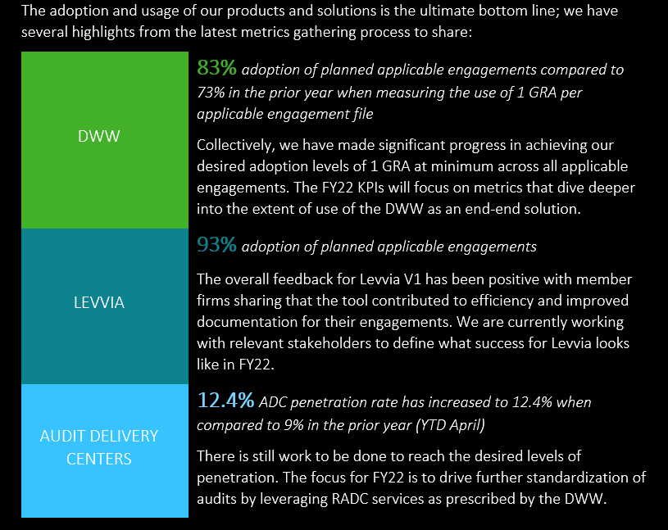
The Bottom Line

Slide 11

Audit Transformation Train
Current Ecosystem (as of November 2021)
Audit Online
Extended Reporting
External Product
Flagship
Content authors
Content System (CMS)
Author, Tag, Link, Publish, and Maintain Content
Risk Assessment Questions, Risks, Controls, Procedures
RADC Portal
Guided Risk Assessment (GRA)
RADC Execution Plan
RADC Onsite Portal
(Omnia, Levvia, EMS and projects)
Policies, Guidance, Questions, Procedures, Templates
GRA – for EMS Files
GRA – for Projects (AS/2 users)
Engagement Management System (EMS)
Phase->Risks->Controls->Procedures
GRAPA
ADC Portal
Where ADC Operations are managed
Risks, Controls, Procedures
Confirmation status
GRA Counts
Iconfirm
Engagement File metadata
Document Extract/TB
Engagement File metadata
Reveal
OMNIA
LEVVIA
Working Paper Transfer
Working Paper transfer to Omnia
Scribe
Audit Archive Tool (AAT)
Omnia archive downloader
Levvia archive downloader
RADC Operational Data
Audit Quality Monitoring & measurement (AQMM)
EM - Engagement monitoring
CR – Consolidated reporting
AQP – Audit quality plan
AQI – Audit quality indicator
EID – External inspection database
Power BI
MI Reporting
Data Extractor
Diagnostics
Quality Dashboards (DQD)
Quality and Milestone indicators for practitioner
Extended Reporting
Audit Transformation Reporting for Global Leaders, MF Transformation Leaders, Deployment & Adoption Leaders, and RADC Leaders. Monitoring adoption of Omnia, Levvia, GRA, RADC, and Azure tools
QlikView (QV)
Monitor Adoption by MF National Office
EMS Engagement Counts
Automated Data Push (ADP)
Share EMS Diagnostics data with ER
Standard Reports (UI)
Custom Reports (Power BI)

Slide 12
Audit Transformations: PI Planning Objectives – New Normal

Slide 13
Business Values|Roadmap
Arnold / Ben

Slide 14
Roadmap of Audit Transformation Product Releases July 2021
Deployed
TBD
PI Planning
Jul 21
Aug 21
Sept 21
Oct 21
Nov 21
Dec 21
Jan 22
Feb 22
Mar 22
EMS 4.9.2
EMS 4.10
EMS
Mar 15-17
Audit Online 5.1
July 17
Audit Online 5.2
Nov 13
Audit Online 5.2
March 19
Audit Online
Jul 13-15
Nov 9-11
Mar 15-17
ER 3.1
Sept 18
ER 4.0
Extended Reporting
Mar 15-17
EA 4.3.2
Excel Analytics
AAT 4.9
Mar 15-17
AAT
AQMM 4.3
July 9
Mar 15-17
AQMM 5.0
Nov 16
AQMM XX
March 18
AQMM
Jul 13-15
Mar 15-17
Diagnostics 5.5
July 16
Diagnostics 5.6
Nov 12
Diagnostics
Jul 13-15
Nov 9-11
Mar 15-17
CMS
Mar 15-17

Slide 15
Audit Transformations: PI Planning Objectives – New Normal
Vision alignment
Business benefits
Product and IT team alignment
Decide ‘next’ steps - Together
Opportunity to see, discuss and set right ‘vision’ together for solution
‘Vision’ – should be both aspirational and achievable keeping new market and user needs in mind.
should provide broader context with ‘short’ & ‘long’ term goal.
Aligning business need with development through ‘vision’ , ‘planning’ and team objectives.
Identify dependencies, and cross-team coordination
Provide opportunity to see initial version of ‘User Experience’ [wire frames etc], architectures related items.
Opportunity to see entire landscape for business need
Alignment on business Priority items
Alignment on development, architectural best practices building Enterprise solutions
Accelerates Decision making process
Opportunity to see a high level plan
Identification and Risks alignment
BE CURIOUS!
Features-PBI refinements as needed
Get PBIs, mock Ups refined/approved for the Iteration
Work on Project Risks
Create and share release plan/strategy
Setting up cadence – Daily meet, backlog calls, Review, Retrospective etc

Slide 16
Business Value – Value Streams
Efficiency
Quality
Standardize
Digitize
Automate
Key Focus Areas – Directly from Leadership Materials
Continued DWW acceleration
Continue enabling the transition to Omnia / Levvia as globalization ramps up
Centralization through significant ramp up in RADC usage
Further expansion of RADC catalogue of services
As part of Audit Transformation “chapter 2” better tools to assist with monitoring adoption reporting
Monitoring Quality & Adoption
Provide tools / hooks / abilities in our existing tools to automate bots (e.g. NWE and APT teams creating a variety of these bots)
Stellar Support and Ongoing Maintenance, including continuous IT alignment by supporting latest requirements around security / infrastructure / operating systems
- You can map all the Features & PBI’s against these Values

Slide 17
Coffee Break | 15 Minutes

Slide 18
Value Stream - Feature Mapping
Audit Online (GRA, RADC) – Lauren
Diagnostics – Andrew/Ezra
CMS – Swetha/Prathap
AQMM – Rose
EMS, AAT, AO Working paper Transfer – Eduardo/Rakesh/Debbie

Slide 19

RADC Portal FY22 Current position, and future growth expectations
Where we are to date
RADC Portal reached 750,000 requests (~8M cumulative m hours) – excluding China Facilitates workflow to over 3K ADC resources 4 RADCs 7 local ADCs Analytics ADC Onshore Center of Excellences Skills Academy being scaled globally Portal serves >40 countries now including USA First stage Levvia integration Concluded as THE workflow tool for Global Audit Additional required functionality in RADC Execution Plan now live Japan transition from current system to RADC Portal by March 2022 Capacity concerns due to growth in user base Significant development backlog Need to retain current state functionality in new platforms Significant business case opportunities not being realised
Future scale
Significant growth expected in next 2 years User base increase to c. 10K+ heads Catalogue increase ~5% 1K+ teams and up to 14 additional centres Integration with Omnia (dev effort required to retain existing functionality) Levvia (dev effort required to retain existing functionality) Global deployment of RADC Execution Plan functionality Rzeszow transition plans dependent on dev efforts Global analytics teams interested in using the portal Significant volume of enhancements and future integrations Positive interest from US based teams Potential cross-service line interest– from Financial Advisory

Slide 20
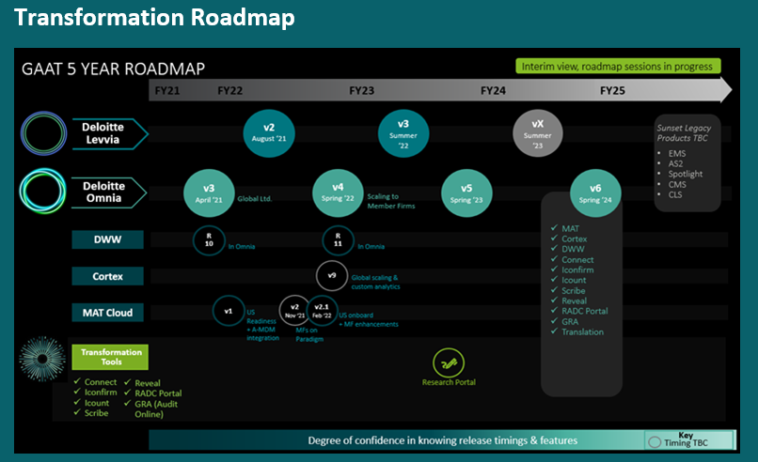

Slide 21
Business Value – Feature Mapping | RADC
Feature | Team | Dependency | DWW Acceleration | Ramp up RADC Usage | Expand RADC Catalog | Transition to Omnia/Levvia | Monitoring Quality & Adoption | Automate Bots | Support and Ongoing Maintenance
MIGRATE AO TO AZURE | All |  |  |  |  |  |  |  | X
SUPPORT RADC FOR LEVVIA V2
Support for Levvia_Link from Levvia | Jaguars | Levvia for full testing |  |  |  | X
RADC Portal Title Bar_Levvia | Jamaica |  |  |  |  | X
Support for Levvia_Enhanced Portfolio Filtering | Jamaica | Levvia APIs |  |  |  | X
Support for Levvia_Using Levvia Entities/Merge 5.1 entities | Jaguars | Levvia APIs |  |  |  | X
Carryforward of Entities | Jaguars |  |  |  |  | X
ONBOARD JAPAN DELIVERY CENTER
Calendar View _Ability to view Requests/capacity by User(s) | Jaguars | Language selection for translation |  | X
Translation of RADC_Language Selection | Autocrats |  |  | X
Translation of RADC_ List View, inc Filtering | Autocrats |  |  | X
Translation of RADC_Quick Edit | Autocrats |  |  | X
Translation of RADC_Extract List | Autocrats |  |  | X
Translation of RADC_Action Dialogs | Technokats |  |  | X
Translation of RADC_ADC Details | Technokats |  |  | X
Translation of RADC_Message and Alerts | Autocrats |  |  | X

Slide 22
Business Value – Feature Mapping | RADC
Feature | Team | Dependency | DWW Acceleration | Ramp up RADC Usage | Expand RADC Catalog | Transition to Omnia/Levvia | Monitoring Quality & Adoption | Automate Bots | Support and Ongoing Maintenance
RADC BUSY SEASON ENHANCEMENTS
Performance Improvements to support Skills Academy /increased Users | All | Database Analysis |  |  |  |  |  |  | X
List View_ Created By | Autocrats |  |  |  |  |  |  |  | X
Ability to Reorder Columns | Autocrats |  |  |  |  |  |  |  | X
Ability for RADC user to create Iconfirm project from ADC portal | Technokats | Iconfirm permission change |  | X
AUTO SCHEDULING ROADMAP
Auto-Scheduling: Assign Teams to Member Firms | Autocrats |  |  |  |  |  |  |  | X
Auto-Scheduling: View Office in List view/Assignment view | Autocrats |  |  |  |  |  |  |  | X
GLOBAL RADC CONFIGURATION ENHANCMENTS
RADC Execution Plan Task Bulk Upload | Technokats |  |  |  |  |  |  |  | X
Allow removal of field even if request is in use | Technokats
RADC Omnia Integration
RADC Portal Title Bar_Omnia | Jamaica |  |  |  |  | X
RADC Listing_Omnia UX | Jamaica |  |  |  |  | X

Slide 23
Business Value – Feature Mapping | RADC
Feature | Team | Dependency | DWW Acceleration | Ramp up RADC Usage | Expand RADC Catalog | Transition to Omnia/Levvia | Monitoring Quality & Adoption | Automate Bots | Support and Ongoing Maintenance
RADC Stretch
Ability to document Comments (Bulk Upload, Multi Submit, Copy/Carryforward) | Autocrats |  |  |  |  |  |  |  | X
RADC Request Configuration Bulk Upload | Technokats |  |  |  |  |  |  |  | X
Auto Assign_Set team by default | Autocrats
JP Translation_Admin screen | Kalini |  |  |  |  |  |  |  | X
Document Transfer Enhancements
Prevent uploading of working papers protected using DCRM | Jamaica |  |  |  |  |  |  |  | X
Omnia Working Paper Transition |  |  |  |  |  |  |  |  | X
Option to merge working paper ref number and name​ | Jamaica
Tech Debt and Defect Fixes | All |  |  |  |  |  |  |  | X

Slide 24
Business Value – Feature Mapping | Diagnostics (QV, DQD, AQMs, DB)
FEATURES | Team | Continued DWW Acceleration | RADC Ramp Up | Expand RADC Catalog | Transition to Omnia/Levvia | Monitoring Quality & Adoption | Automate Bots | Support and Ongoing Maintenance
DIAGNOSTICS QLIKVIEW (QV) & DATABASE (CORE)
Qlikview: Working Paper Report | Data Dynamics |  |  |  |  | X
2. Qlikview & Quality Dashboards: Risk Decisions in Benchmarking | Data Dynamics |  |  |  |  | X
DB: Minor enhancements to Audit Quality Milestones (supplemental data files) | Data Dynamics |  |  |  |  |  |  | X
4. Performance Enhancements to Qlikview and Quality Dashboards | Data Dynamics |  |  |  |  |  |  | X

Slide 25
Business Value – Feature Mapping | EMS, AAT & CMS
FEATURES | Team | Continued DWW Acceleration | RADC Ramp Up | Expand RADC Catalog | Transition to Omnia/Levvia | Monitoring Adoption | Automate Bots | Support and Ongoing Maintenance
EMS
Defect Fixes and enhancements | Bahamas |  |  |  |  |  |  | X
Production Support | Bahamas |  |  |  |  |  |  | X
Cloud migration for EMS | Bahamas |  |  |  |  |  |  | X
AAT
Retrieve for Modification Redesign- Destruction, Rejection, Reports | Amigos |  |  |  |  |  |  | x
Diamonde 2.0/Bolt 2.0 support – Retaining Passwords | Amigos |  |  |  |  |  |  | x
DUNS/UHC Support (Import, Apply to archives, View, Search, Reports) | Amigos |  |  |  |  |  |  | x
Enhancing Levvia Integration & Downloader | Amigos |  |  |  | x
Enhancing Omnia Archive Downloader | Amigos |  |  |  |  |  |  | x
Production Support | Amigos |  |  |  |  |  |  | x
CMS
Architectural runway – Technical backlogs | Content Fosters |  |  |  |  |  |  | X
Cloud Migration | Content Fosters |  |  |  |  |  |  | X
Production support | Content Fosters |  |  |  |  |  |  | X

Slide 26

AQMM Engagement Monitoring
Transformed integrated processes and tools reflective of ISQM1
AQMM Engagement Monitoring Program
Monitoring Process
Enabling Tools
Outcomes
Stratification of portfolio
Utilizing a suite of Monitoring Tools
AQMM Platform
driving consistency, efficiency and insights
Engagement selection / design of monitoring activities
Health Checks
Archived Reviews
In-Flight Reviews
Health Checks
Archived Reviews
In-Flight Reviews
Engagements grouped into four groups based on risk
Enhanced process shaped by the requirements of ISQM1 (Para 36-38)
Diagnostics Extended Reporting
Integrated use of Data throughout the Engagement Monitoring Process

Slide 27
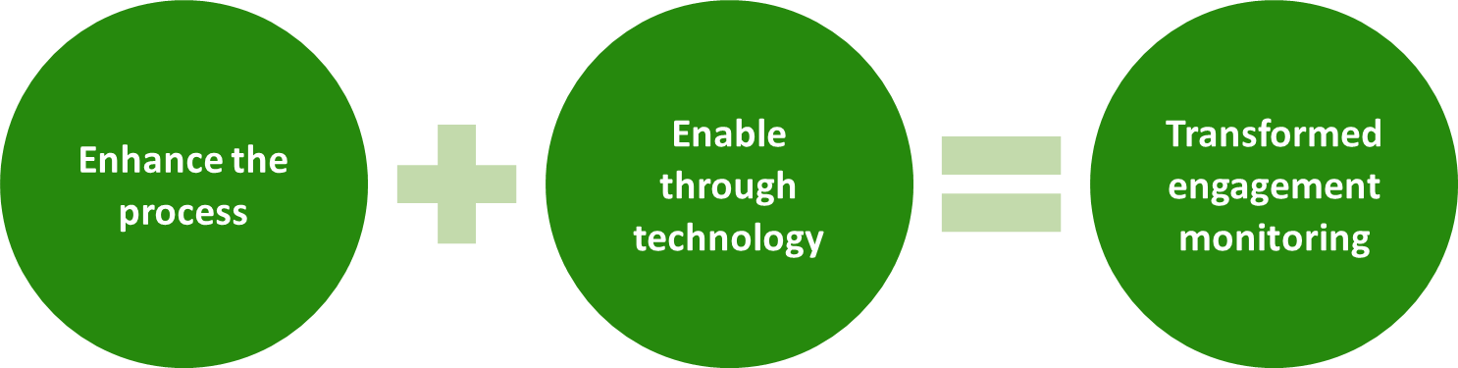
Archived Engagement Reviews Transformation Project
The objective of the Archived Engagement Reviews Transformation Project is to significantly improve the effectiveness and efficiency of archived engagement reviews globally through the (a) enhancement of processes and controls, and (b) the enabling of technology by replacing DPRS with the cloud-based AQMM Platform.
Enhance the process:
Scalable, tailorable and more intuitive
Facilitates compliance with ISQM1
Globally consistent
Enable through technology:
Enhanced transparency
Greater efficiency
Increased flexibility
Transformed engagement monitoring:
Provides relevant, reliable and timely information about the design, implementation and operation of the system of quality management

Slide 28
Business Value – Feature Mapping | AQMM - Falcon Heavy
FEATURES | Team | Continued DWW Acceleration | RADC Ramp Up | Expand RADC Catalog | Transition to Omnia/Levvia | Monitoring Quality & Adoption | Automate Bots | Support and Ongoing Maintenance
EXTERNAL INSPECTION DATABASE
1. EID - Submission and review workflow for external inspections | Falcon Heavy |  |  |  |  | X
ENGAGEMENT MONITORING
2. EM/OAR - OAR content management | Falcon Heavy |  |  |  |  | X
3. EM/OAR - Planning the OAR | Falcon Heavy |  |  |  |  | X
4. EM/OAR - Performing the OAR | Falcon Heavy |  |  |  |  | X
5. EM - Bulk import of engagement, IFER content reordering and other application enhancements. | Falcon Heavy |  |  |  |  | X
6. EM/HC - DWW health check creation and workflow | Falcon Heavy |  |  |  |  | X
7. EM - Data retention/ Data archival and Data purge. | Falcon Heavy |  |  |  |  | X
AUDIT QUALITY INDICATORS
7. AQI - Update the validation rules for AQI data entry pages | Falcon Heavy |  |  |  |  | X
AQMM PLATFORM
8. AQMM - Platform level changes and prod defects | Falcon Heavy |  |  |  |  | X

Slide 29
Business Value – Feature Mapping | AQMM – Saturn V
FEATURES | Team | Continued DWW Acceleration | RADC Ramp Up | Expand RADC Catalog | Transition to Omnia/Levvia | Monitoring Quality & Adoption | Automate Bots | Support and Ongoing Maintenance
ENGAGEMENT MONITORING
EM/AER - Engagement Profile | Saturn V |  |  |  |  | X
EM/AER – AER Configurations | Saturn V |  |  |  |  | X
EM/AER - Performing an AER | Saturn V |  |  |  |  | X
EM/AER – Planning module of an AER | Saturn V |  |  |  |  | X
EM/AER – Evaluating module of an AER | Saturn V |  |  |  |  | X
EM/AER – Concluding module of an AER | Saturn V |  |  |  |  | X

Slide 30

AUDIT QUALITY MONITORING AND MEASUREMENT
Audit Quality Plan application
High level release overview (Falcon Heavy)
- External inspection database
Building a submission flow for the inspections for the global team to review and take appropriate action.
- Engagement Monitoring
Creation and publishing Other assurance review (OAR) questionnaires
Initiation, scoping and result modules of OAR.
Reorder the authored content for IFER.
Introducing a new lifecycle for the DWW health checks.
Bulk import of engagement profiles.
Data archival and data purge for engagement monitoring
- Other application enhancements
AQI – Adding validations to prevent invalid data entry.
Production defect fixes

Slide 31
AUDIT QUALITY MONITORING AND MEASUREMENT
Audit Quality Plan application
High level release overview (Saturn V)
Engagement Monitoring (Audit engagement review)
1. Engagement Profile creation for AER
2. Configuration module for AER for individual geographies
- Defining the list for Practice Office, Issuing office
- Signoff configuration
- Finding and insight details configuration
2. Creation/Initiation of AER and assigning various roles to users.
3. Planning the AER and define the scope of the review.
4. Performing the AER
- Content integration with InK system.
- Managing the findings, insights transformational observations and good practices.
5. Concluding Module for AER
- Concluding memo
- Overall evaluation and signoffs

Slide 32
Coffee Break | 15 Minutes

Slide 33
Architectural Vision
Janine | Jignesh |Anubha | Karthik | Ramesh |Swetha

Slide 34
Audit Online - Architecture
Architectural enablers – These are created to build the architectural runway, which allows smoother and faster development.
Performance improvements
HTTP Client Instances
Reduce Competency Data Representing "No Competency"
Transaction Improvement (Multi-Edit, Bulk Upload, Upload Documents)
Enhance All-Request Loading (Sync Data, Inline Edits [Reduce Unnecessary data in API], Request Type Config)
User Restriction based on Independence Redesign
EMS, CMS, AO, Diagnostics integration on Cloud – Standalone/Always-On
Infrastructure enablers – These are created to build, enhance, and automate the development, testing, monitoring, and deployment environments. They facilitate faster development, higher-quality testing, and a faster Continuous Delivery Pipeline.
AppInsights – Move DAloggerDB to AppInsights, additional OnPrem calls to Central for logging onPrem logs (Architects)
AppInsights - DataLoader runbook replacements (Architects)
Using failover groups for BCP (CloudEagles)
Automation of scripts that are run from DevOps (I.e., onboarding, pricing, etc.) (Architects/CloudEagles)
User-managed Identity for SQL Connection (China and PowerBI env compatibility) (Jaguars/CloudEagles)
Cleanup of trusted apps configuration (Architects/CloudEagles)
Upgrade Central DB Compatibility Level to SQL 2016 (Architects)
SP for Deleting Central Activities and Related Data (Autocrats)

Slide 35
Audit Online - Architecture (Continued)
Compliance enablers – These facilitate managing specific compliance activities, including Verification and Validation (V&V), documentation and signoffs, and regulatory submissions and approvals.
Contrast SQL Injection Vulnerability (Autocrats)
Automate Contrast Agent Version Upgrades (Architects/Cloud Eagles)
Exploration enablers – These support research, prototyping, and other activities needed to develop an understanding of customer needs, including the exploration of prospective Solutions and evaluating alternatives.
Design - Multi-version, copy/carry forward, reassign requests support in Levvia and Omnia (Architects)
Design - IConfirm integration with Omnia and Levvia (Architects)
Design - China RADC integration with Omnia and Levvia (Architects)
Design – Omnia Execution Plan (Architects)
Design - Auto-scheduling - Schedulers to Choose Autoschedule or Not (Architects)
Design - Bulk Upload Request Config (Architects)
Design - Allow for RADC Placeholder Assignments (Architects)
Design - Ability to Set Standard Capacity by MF vs DC (Architects)

Slide 36
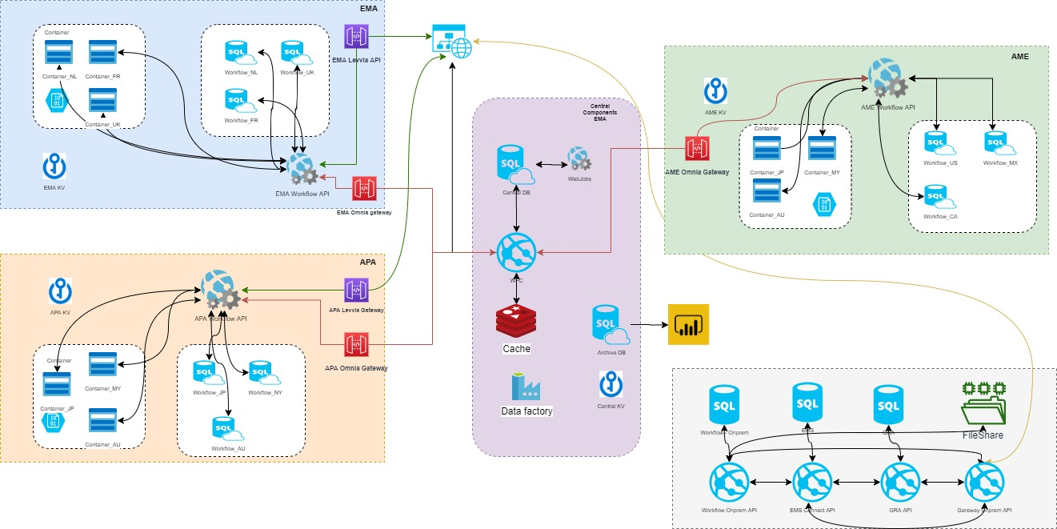
Audit Online - Multi-Geo Architecture (no change this release)

Slide 37
Diagnostics Architecture
Architectural enablers – These are created to build the architectural runway, which allows smoother and faster development.
Performance improvements
http competencies – Two APIs in IFM section
Report generation – GRA POA, Internal Control Report
Infrastructure enablers – These are created to build, enhance, and automate the development, testing, monitoring, and deployment environments. They facilitate faster development, higher-quality testing, and a faster Continuous Delivery Pipeline.
AppInsights – On-Prem
Automation of scripts that are run from DevOps (I.e., onboarding, Submitting Scans, etc.)
Code cleanup ( i.e., API and UI code )
Moving Diagnostics to Cloud - PoC
Compliance enablers – These facilitate managing specific compliance activities, including Verification and Validation (V&V), documentation and signoffs, and regulatory submissions and approvals.
Update CSP and Http responses
Upgrade to TLS 1.3 - Subject to Global recommendations

Slide 38
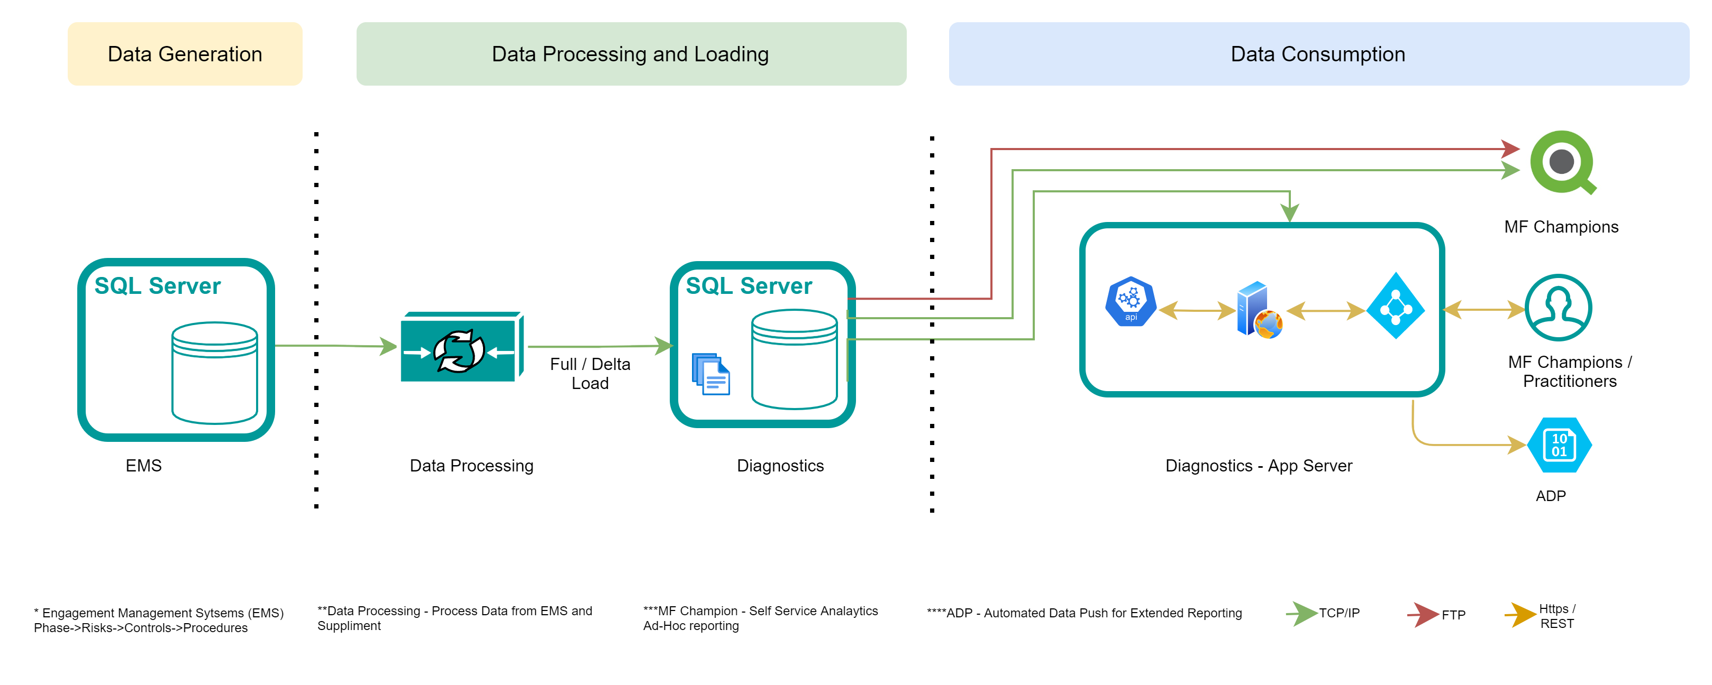
Diagnostics (no change this release)

Slide 39
AQMM – Architecture
Exploration enablers – These support research, prototyping, and other activities needed to develop an understanding of customer needs, including the exploration of prospective Solutions and evaluating alternatives.
Ink integration for review questionnaires
Architectural enablers – These are created to build the architectural runway, which allows smoother and faster development.
Ink integration for AER
Database Normalization
Log Archiving
Infrastructure enablers - These are created to build, enhance, and automate the development, testing, and deployment environments. They facilitate faster development, higher-quality testing, and a faster Continuous Delivery Pipeline.
Implementation of Redis – Control Data
Automation of SAST Scan from Azure DevOps

Slide 40
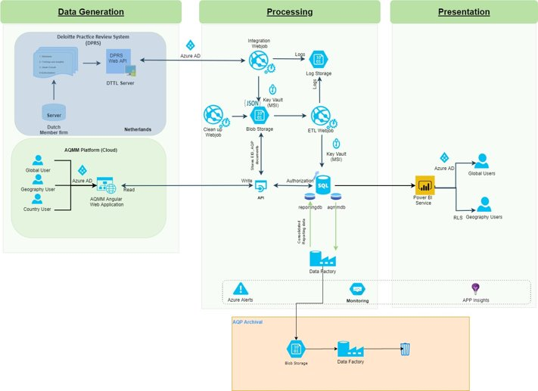
AQMM (Current State)

Slide 41
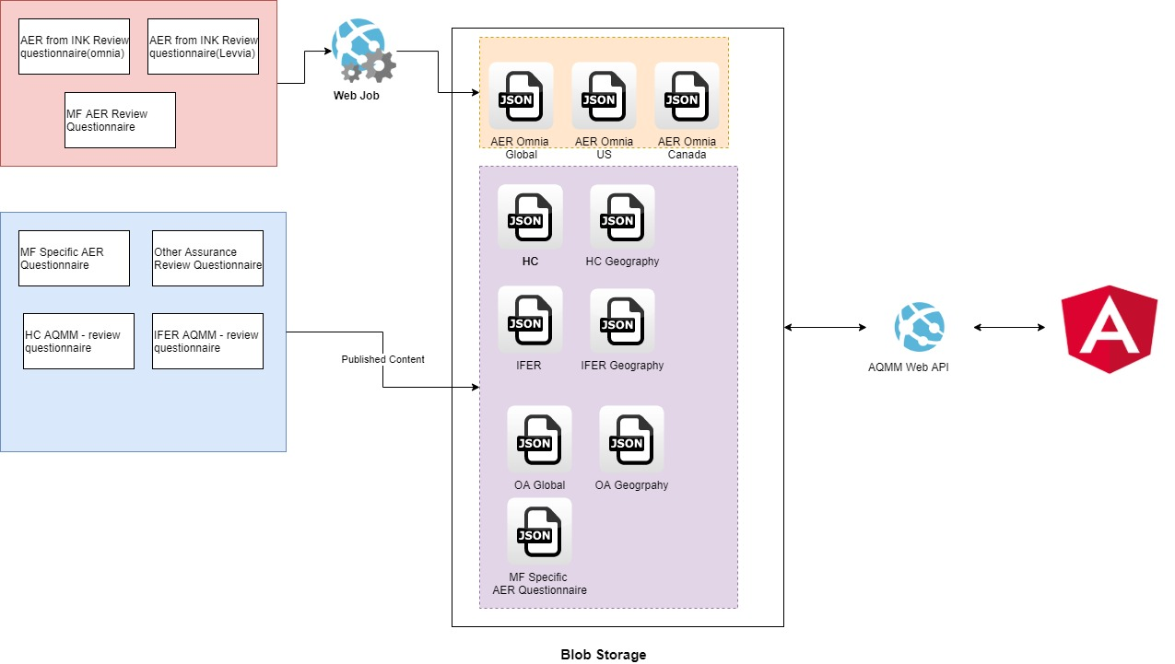
AQMM - Ink Integration

Slide 42
CMS – Architecture
Architectural enablers
Webtop UCF Certificates upgrade
Webtop Upgrade to 16.7.4
OS and SQL upgrade
Documentum administrator (Docadmin) upgrade
Cloud Migration

Slide 43
DevOps Vision
Anindya Ghosh (DL)

Slide 44
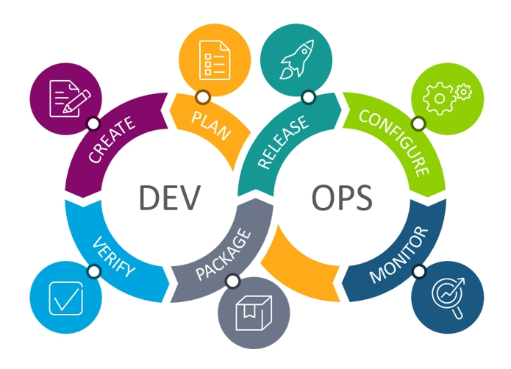
DevOps – The Way of Working
Common
Remove project specific pools for release and use common pools
Automate start/stop of webjobs
Revise DNS entries
Remove classic pipelines and implement YAML pipelines for release (code, database, adf and infrastructure)
Implement traffic manager
Automate Power BI password update post password rotation
90-day password rotation alert for all apps
Remove diagnostic logging for ADF and setup new standard alerts
ADF – GIT Integration
Standard retention for Production databases to be 35 days
Remove manual updates on databases and use pipelines [100% automation]
Cost optimization
Power BI deployment automation
Automate post deployment validation through pipelines
Gitflow for infrastructure repository
Audit Online
BCP setup using YAML
Perform test on Non-Production
Perform BCP test
SQL MSI – China and Power BI
Remove certificate dependency for iConfirm and use SPN authentication
Revisit schedules for iConfirm webjobs
Handling archive folder for China Central
Moving OnPrem to Cloud
Automating contrast upgrade
Health check
AQMM
BCP setup using YAML
Perform test on Non-Production
Password rotation [MANDATORY]
Organize build and release pipelines using YAML
SAST scan automation
ADF pipeline fix
NO MANUAL CHANGES ON PRODUCTION
AZURE POLICY COMPLIANCE ON RESOURCES AND DENY POLICIES

Slide 45
Security Compliance Testing
Janine Kutas-Hille

Slide 46
Security Assessments
To support quality control objectives in accordance with U.S. AAM 22852, Controls over Audit Tools, or U.S. PCAOB AAM 22852, Controls over Audit Tools, the audit and assurance tool technology environment (i.e., application, database, operating system) needs to be evaluated prior to initial production deployment, major releases, or version upgrades.
Assessment Type | Definition | Tool/team used
Static Application Security Test (SAST) | A static code analysis tool to review codes against known code-level security flaws. | Veracode Global AAT – Fortify* (Vigilant Shield)
Dynamic Application Security Test (DAST) | An automated dynamic code analysis tool to detect faults in a running application. | Global AAT – WebInspect AppSpider Contrast Synopsys (External)
Penetration Application Security Test | Simulated cyber attacks, both automated and manual, against applications to assess the ability to uncover vulnerabilities, such as code injection attacks or escalated access privileges. | VMS (Internal) Synopsys (External)
Network Vulnerability and SSL Test | The process of reviewing and analyzing a network servers and SSL certificates for possible security vulnerabilities and loopholes. | Kenna / Qualys
*Fortify and Contrast are preferred SAST tools as of November 2020

Slide 47
Security Assessment Requirements
Release Type | Major Release | Semi-Major Release | Minor Release | “Frequent” Releases (AGILE development)
Static Application Security Test (SAST)
Dynamic Application Security Test (DAST) | Included in Pen Test | OR | At least once every 6 months
Penetration Application Security Test |  |  | At least annually
Network Vulnerability and SSL Test |  |  | At least annually
WhiteSource Compliance Scan |  |  | At least annually
Required for release type
Note: Tests should be performed based on the applicability of the system codes and configurations, as well as timing and results of prior tests, including limited-scope retest to confirm remediations. In some cases, certain tests may not be available due to the design of the application (e.g., cannot bypass MFA, on-prem applications, etc.).

Slide 48
Security Assessments Results and Remediation
Assessment Type | Requirements prior to deployment* | Critical / Very High | High | Medium/ Moderate | Low | Minimal / Informational
Static Application Security Test (SAST) | Cannot contain unremediated critical or high vulnerabilities >90 (Veracode) >80 (Fortify) | Critical | High | Medium | Low | Informational / Bad Practice
Dynamic Application Security Test (DAST) | Cannot contain unremediated critical or high vulnerabilities >80 (Fortify) >60% route coverage (Contrast) | Critical | High | Medium | Low | Informational / Note / Bad Practice
Penetration Application Security Test | Cannot contain unremediated critical or high vulnerabilities | Very High / Critical | High | Medium | Low | Informational
Network Vulnerability Test | Cannot contain vulnerabilities with score of 5 or 4 | 5 Rating | 4 Rating | 3 Rating | 2 Rating | 1 Rating
SSL Test | Score of A or above | N/A | N/A | N/A | N/A | N/A
Remediation Timing (Calendar Days) |  | 5 (US)^ 9 (Global)^^ | 10 (US) 29 (Global) | 30 (US) 53 (Global) | 60 (US) 83 (Global) | N/A
*Exceptions to the requirements must be approved by Audit & Assurance BISO Leadership
^ US applications are defined as hosted within the US infrastructure
^^ Global applications are defined as systems hosted outside of the US infrastructure

Slide 49
PI5 Retro Items

Slide 50
CONTINUE
Continue to have Integration packages delivered on time.
Continue collaboration between Diagnostics and AO teams.
Continue to have co-ordination between TA's and data dynamics team that will result in improved performance on AO Dashboards
STOP
STOP late evening meetings in USI. Solution: Have a Lead Dev in USI who can address issues during USI times. Build skillsets in USI to avoid dependencies on US Architects.
STOP adding UPDATE/INSERTS etc.. in prod subscription including manual scripts.

Slide 51
START
START fixing known defects during the PI and it should be planned.
START raising resource constraints in ART sync meetings.
START adding RND Items for Prod Non Repro Instances in the Prior Sprint before committing to the actual item. Ensure the same in Sprint Planning.
START having weekly grooming sessions with teams (Amigos)
START adding some scope for code refactoring, as in along the lines of code maintainability. Architects to review this feedback.
START identifying architecture/Implementation when designing PBIs and size the stories. Have more time for refinements.
START having better oversight of dependencies with external teams (Levvia, Omnia, Iconfirm, etc) – hoping Engagement Leaders can help manage.
START finalizing Business Scope before the Release Planning, as it consumes a good amount of effort to undo the changes/scope in between the Release.
START adding capacity on defect fixes each sprint.

Slide 52
Product Increment Milestones

Slide 53

PI Milestones *
*This is for products releasing around end of PI. For those not releasing in November, your Code Freeze dates and UAT may differ. Please confirm with your SM/DL/TL for schedule.
Start: July 14, 2021
Official Start: July 16, 2021
4 Development Sprints
First Sprint – 3 weeks
Second Sprint – 3 weeks
Third sprint – 3 weeks
Fourth Sprint should allow for buffer – 1.5 weeks for those releasing in November
RC 1 (Bronze) Code Freeze: Sep 24, 2021; only P1/P2 defects post
Regression, Performance, Backward Compatibility, China, Integration, PEN – Start Sep 27, 2021
RC 2 (Silver) Code Freeze: 8 October, 2021; only showstoppers P1 post
UAT – Week of 11 October 2021
Gold Code: 29 Oct 2021; Gold Code=Ready for Staging
Production Deployment:
Nov 13 for AO
Innovation Sprint: Sprint 91; begins 27 October 2021
PI Planning for Nov PI: (Nov 9 - 11, 2021)
Start next release on Nov 17 (March 2022 release)

Slide 54
Audit Transformations: PI Cadence & Release Dates
Iteration # | Start Date | Finish Date | Release Date | PI Planning
81 - 1 | Mar 31, 2021 | Apr 20, 2021 | April 1 (AQMM)
82 - 2 | Apr 21, 2021 | May 11, 2021 | Apr 24 (CMS)
83 - 3 | May 12, 2021 | June 1, 2021
84 – Testing | June 2, 2021 | June 22, 2021
85 - IP | June 23, 2021 | July 13, 2021 | July 17, 2021 (Audit Online & DAD) July 9 (AQMM) | PI 6 - July 13 - 15, 2021
86 – 1 | July 14, 2021 | Aug 3, 2021
87 – 2 | Aug 4, 2021 | Aug 24, 2021
88 – 3 | Aug 25, 2021 | Sep 14, 2021
89 - 4 | Sep 15, 2021 | Oct 5, 2021 | (EMS)
90 – Testing | Oct 6, 2021 | Oct 26, 2021
91 – IP | Oct 27, 2021 | Nov 16, 2021 | Nov 13, 2021 (Audit Online & DAD), Nov 16 (AQMM) | PI 7 - Nov 9 – 11, 2021
92 – 1 | Nov 17, 2021 | Dec 7, 2021
93 – 2 | Dec 8, 2021 | Dec 28, 2021
94 – 3 | Dec 29, 2021 | Jan 18, 2022
95 – 4 | Jan 19, 2022 | Feb 8, 2022
96 – 5 | Feb 9, 2022 | Mar 1, 2022
97 – IP | Mar 2, 2022 | Mar 22, 2022 | Mar 18 (AQMM) (EMS) Mar 19 (Audit Online, DER & DAD) | PI 8 - Mar 15 – 17, 2022

Slide 55
Audit Transformations: PI Cadence & Release Dates
Iteration # | Start Date | Finish Date | Release Date | PI Planning
98 - 1 | Mar 23, 2022 | Apr 12, 2022
99 - 2 | Apr 13, 2022 | May 3, 2022
100 - 3 | May 4, 2022 | May 24, 2022
101 – 4 ½ testing | May 25, 2022 | June 14, 2022 | June 6 – 14, Mid Release Testing
102 - 5 | June 15, 2022 | July 5, 2022
103 – 6 | July 6, 2022 | July 26, 2022
104 – 7 – ½ testing | July 27, 2022 | Aug 16, 2022
105 – Testing | Aug 17, 2022 | Sep 6, 2022 | UAT – Aug 22 – 26, 2022
106 - IP | Sep 7, 2022 | Sep 27, 2022 | Sep 17, 2022 | PI 9 – Sep 20 – 22, 2022
107 -1 | Sep 28, 2022 | Oct 18, 2022
108 – 2 | Oct 19, 2022 | Nov 8, 2022
109 – 3 | Nov 9, 2022 | Nov 28, 2022
110 – 4 1/2 testing | Nov 29, 2022 | Dec 20, 2022 | Dec 12 – 20, Mid Release Testing
111 – 5 | Dec 21, 2022 | Jan 10, 2023
112 – 6 | Jan 11, 2023 | Jan 31, 2023
113 – 7 – ½ testing | Feb 1, 2023 | Feb 21, 2023
114 – Testing | Feb 22, 2023 | Mar 14, 2023 | UAT Mar 6 – 10, 2023
115 – IP | Mar 15, 2023 | Apr 4, 2023 | March 25, 2023 | PI 10 – Mar 28 – 30. 2023

Slide 56
Audit Transformations: PI Cadence & Release Dates
Iteration # | Start Date | Finish Date | Release Date | PI Planning
116 – 1 | Apr 5, 2023 | Apr 25, 2023
117 – 2 | Apr 26, 2023 | May 16, 2023
118 – 3 | May 17, 2023 | June 6, 2023
119 – 4 ½ testing | June 7, 2023 | June 27, 2023
120 – 5 | June 28, 2023 | July 18, 2023
121 - 6 | July 19, 2023 | Aug 8, 2023
122 – 7 – ½ testing | Aug 9, 2023 | Aug 29, 2023
123 – Testing | Aug 29, 2023 | Sep 19, 2023 | Sept 10
124 – IP | Sep 20, 2023 | Oct 10, 2023 | Sep 30, 2023 | PI 11 - Oct 3 – 4, 2023 (Oct 2 will be USI holiday)

Slide 57
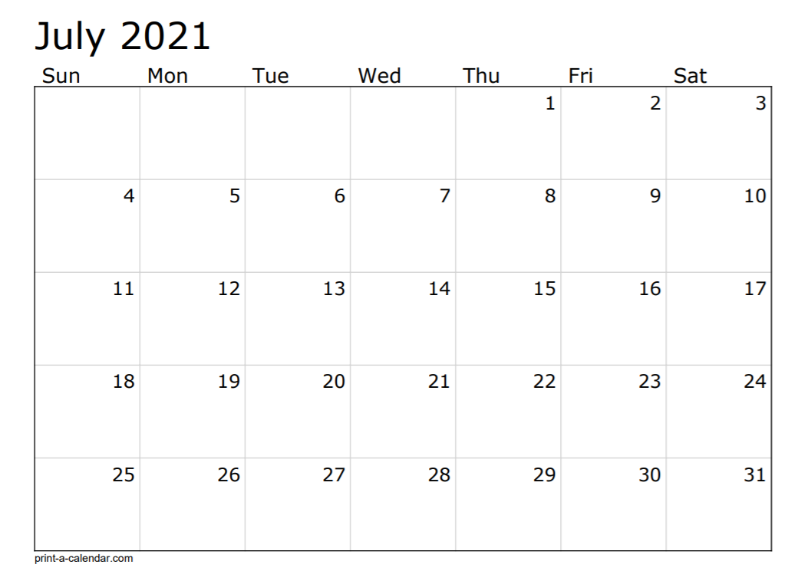


Tech Deployment
AO/ER Code Package
US Holiday
US Holiday
AQMM Deploy
AO Start
PI Planning - 6
Sprint 86
AO/DAD Deploy

Slide 58
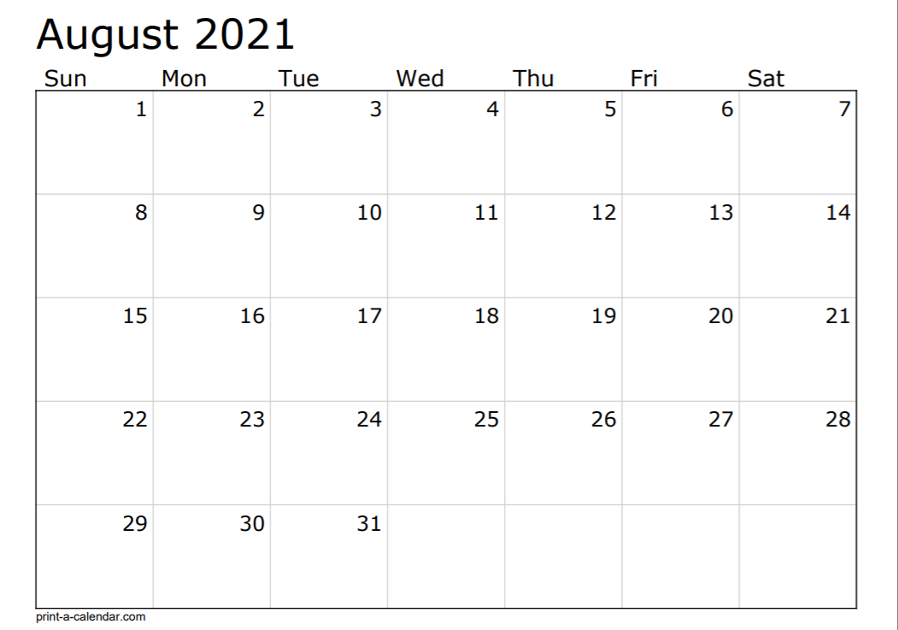
Sprint 87
Sprint 88

Slide 59
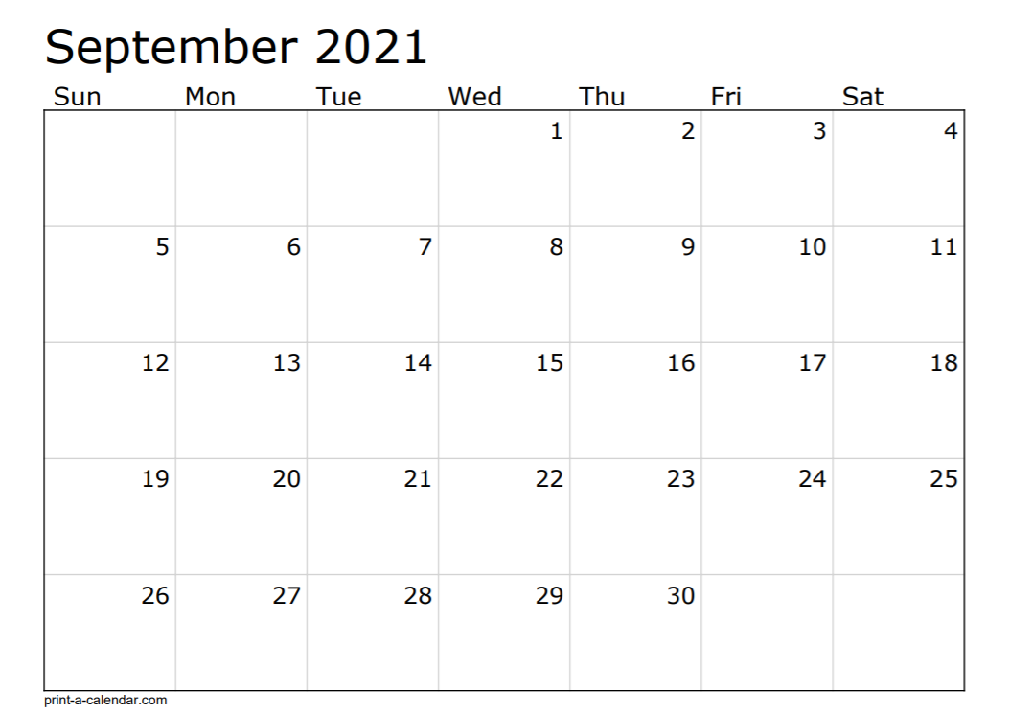

US Holiday
USI – Holiday
ER Deploy
Sprint 89
AO Code Freeze
Testing (Regression, China, Backward, Integration, Performance) and Critical Defects

Slide 60
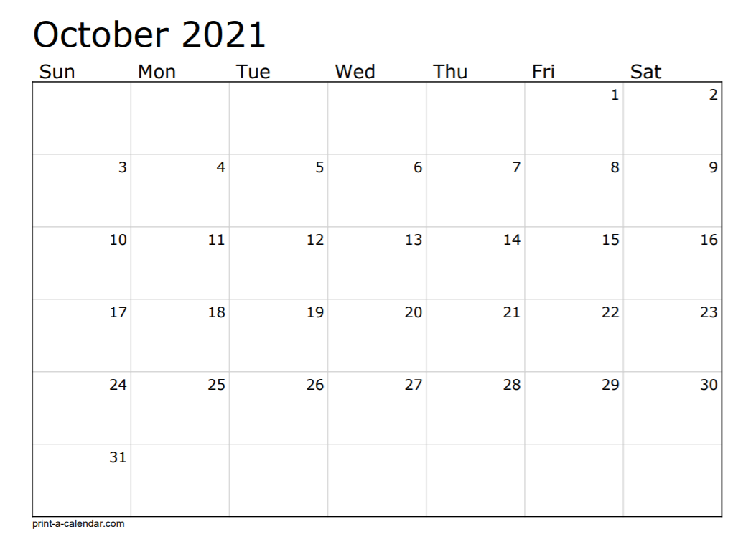

Testing (Regression, China, Backward, Integration, Performance) and Critical Defects
Sprint 90
Final UAT
Testing (Regression, China, Backward, Integration, Performance) and Critical Defects
USI – Holiday
Testing (Regression, China, Backward, Integration, Performance) and Critical Defects
AD Hoc Testing/Buffer
Sprint 91
AO Gold Code
AQMM Gold Code

Slide 61
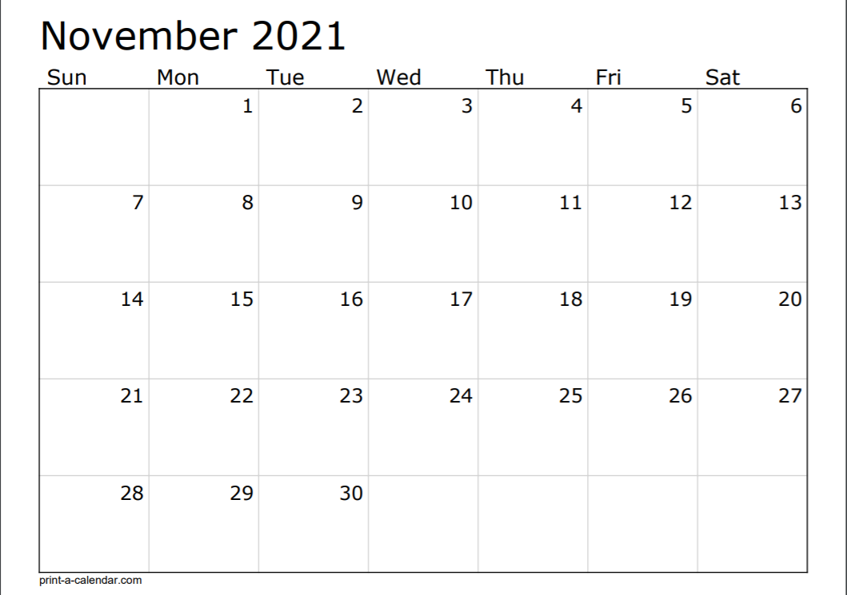
Tech Deployment
USI – Holiday
AO /DAD Deploy
PI Planning - 7
AO Start
AQMM Deploy
Sprint 92
US Holiday

Slide 62
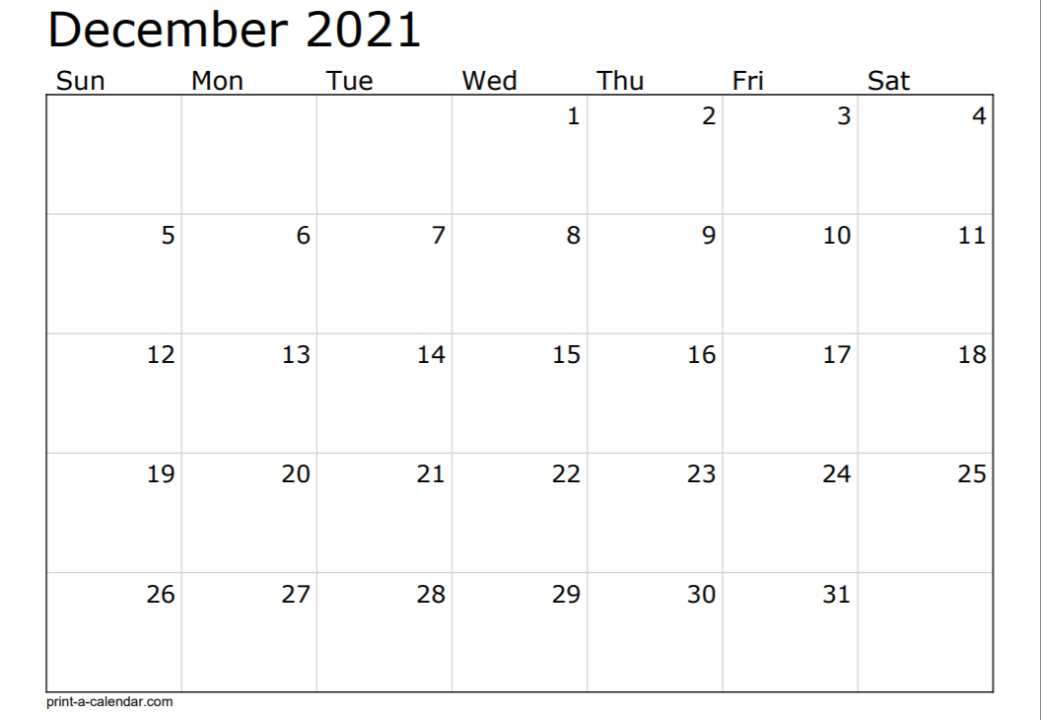
Sprint 93
US/USI - Holiday
Sprint 94

Slide 63
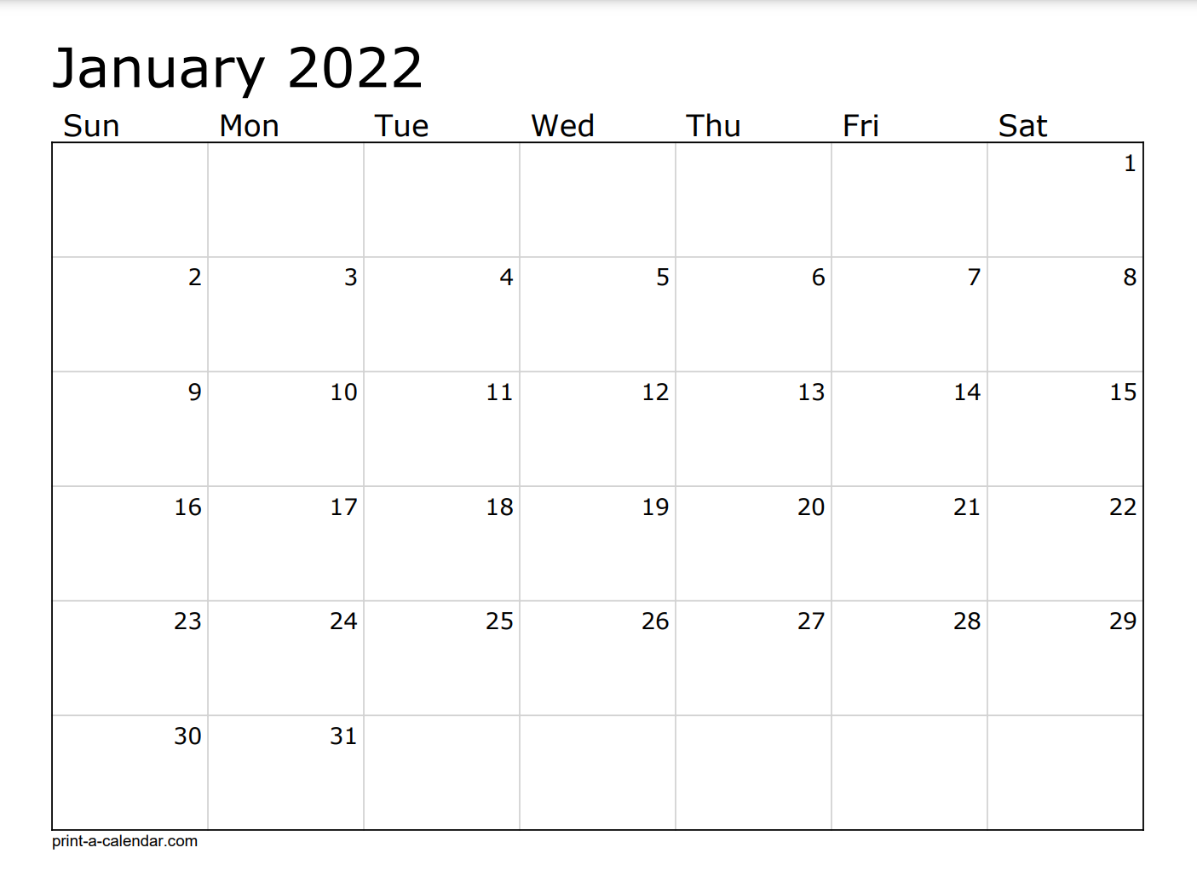
USI – Holiday
US Holiday
Sprint 95
AO Code Freeze
USI – Holiday

Slide 64
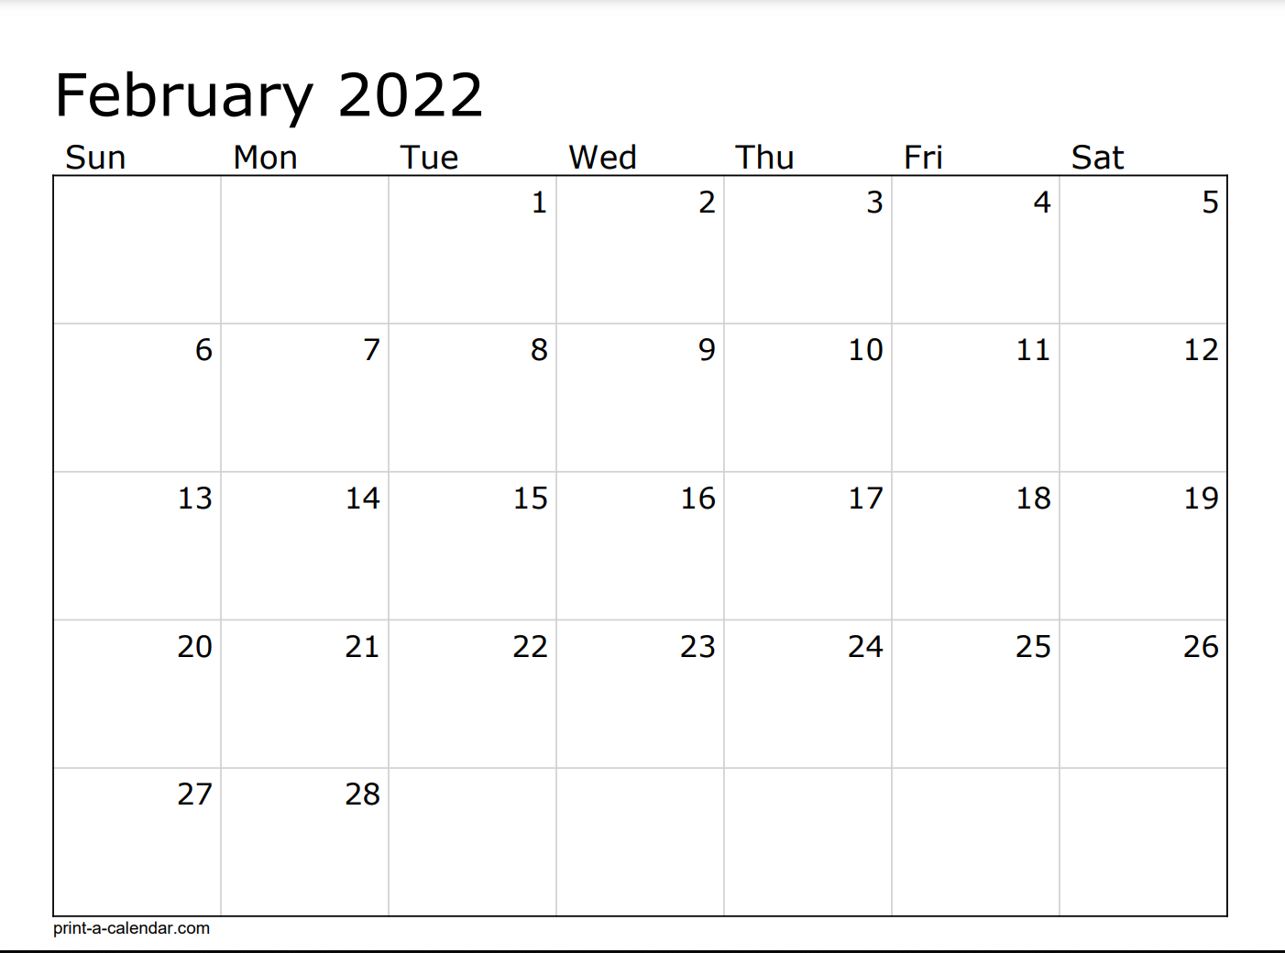
Testing (Regression, China, Backward, Integration, Performance) and Critical Defects
Testing (Regression, China, Backward, Integration, Performance) and Critical Defects
Sprint 96
Testing (Regression, China, Backward, Integration, Performance) and Critical Defects
Final UAT
Testing (Regression, China, Backward, Integration, Performance) and Critical Defects
Ad Hoc Testing/Buffer

Slide 65
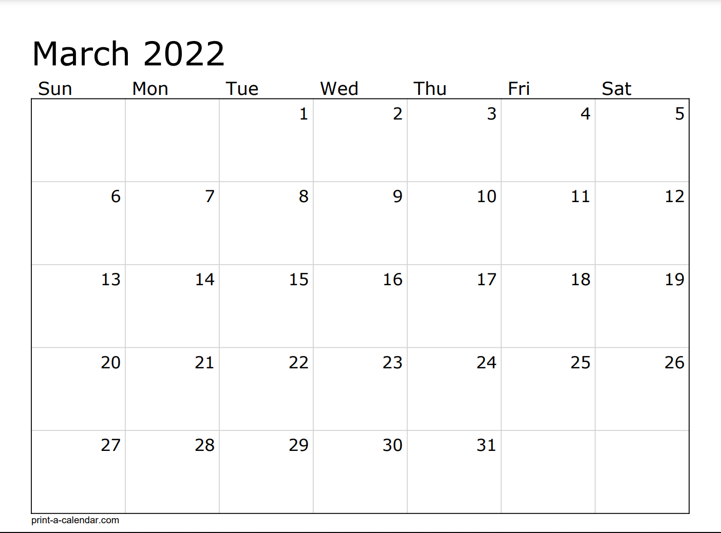
Ad Hoc testing/Buffer
Gold Code
Sprint 97
Technical Deployment
AQMM/ENS Deploy
AO/ER/DAD Deploy
PI Planning - 8
AO Start
Sprint 98 - 1

Slide 66
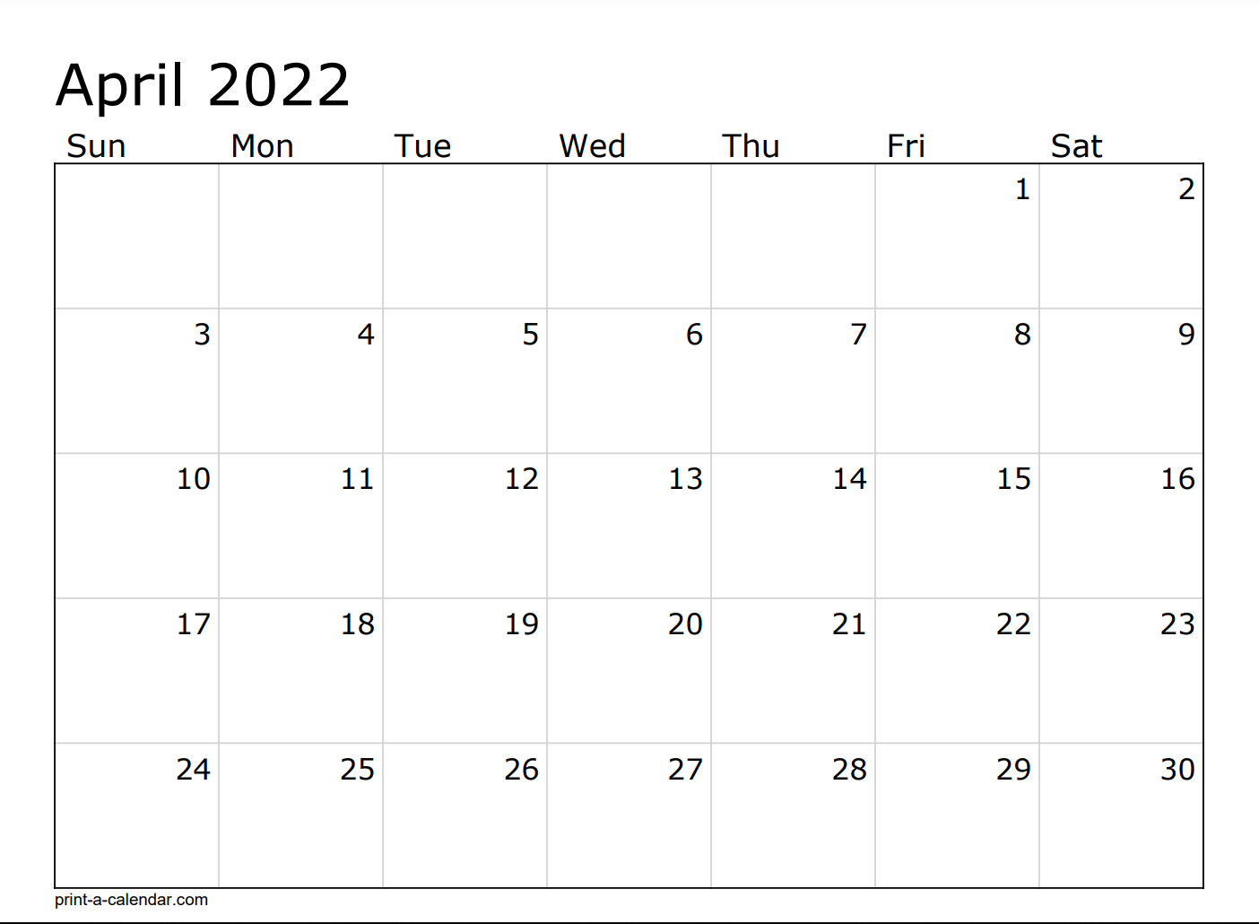
Sprint 99 - 2
USI – Holiday

Slide 67
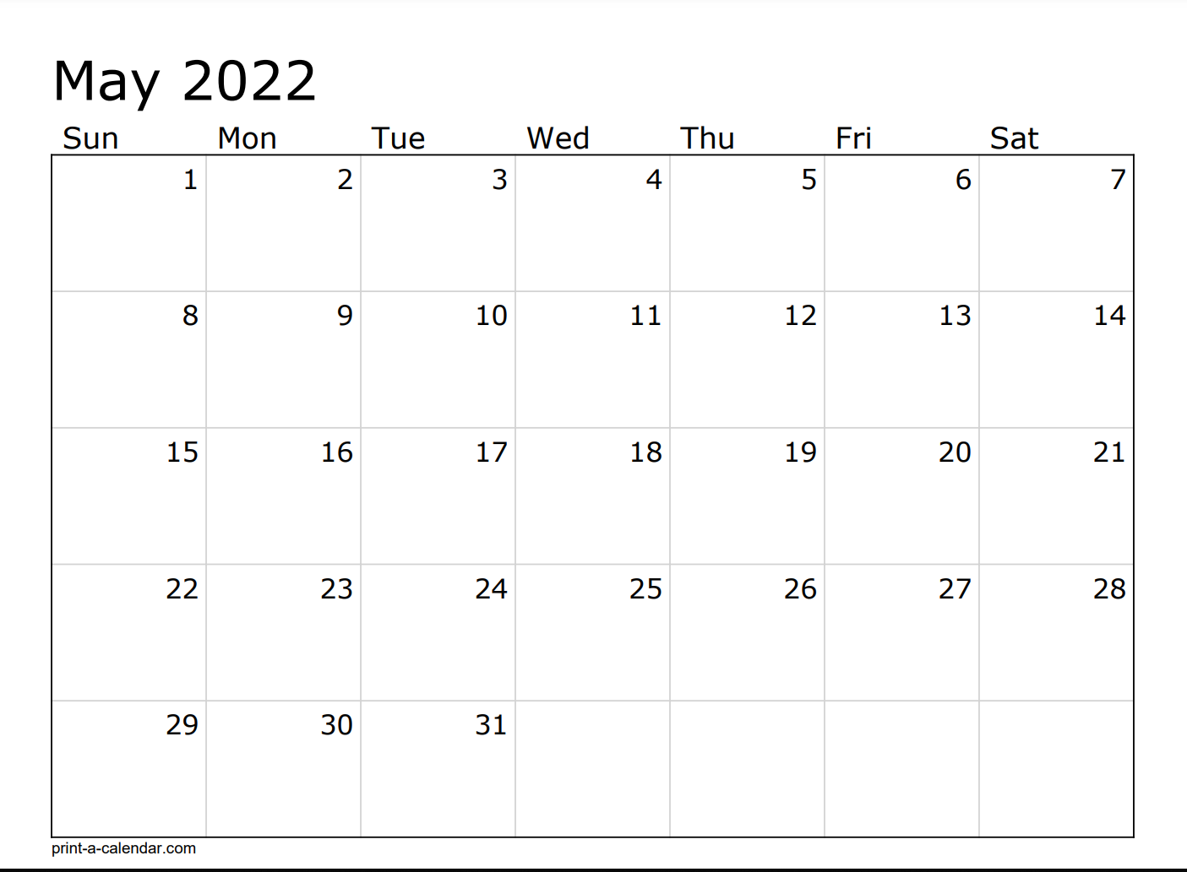
USI – Holiday
Sprint 100 - 3
Sprint 101 – 4 – ½ Testing
US Holiday

Slide 68
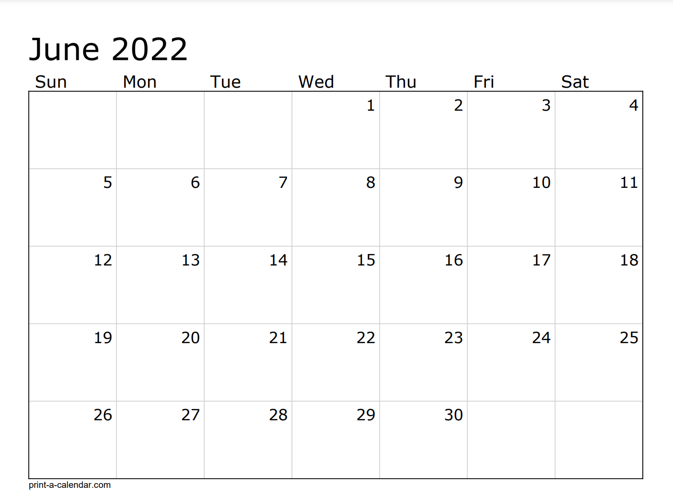
USI – Holiday
Mid Release Testing
Mid Release Testing
Sprint 102 - 5
Gold Code

Slide 69
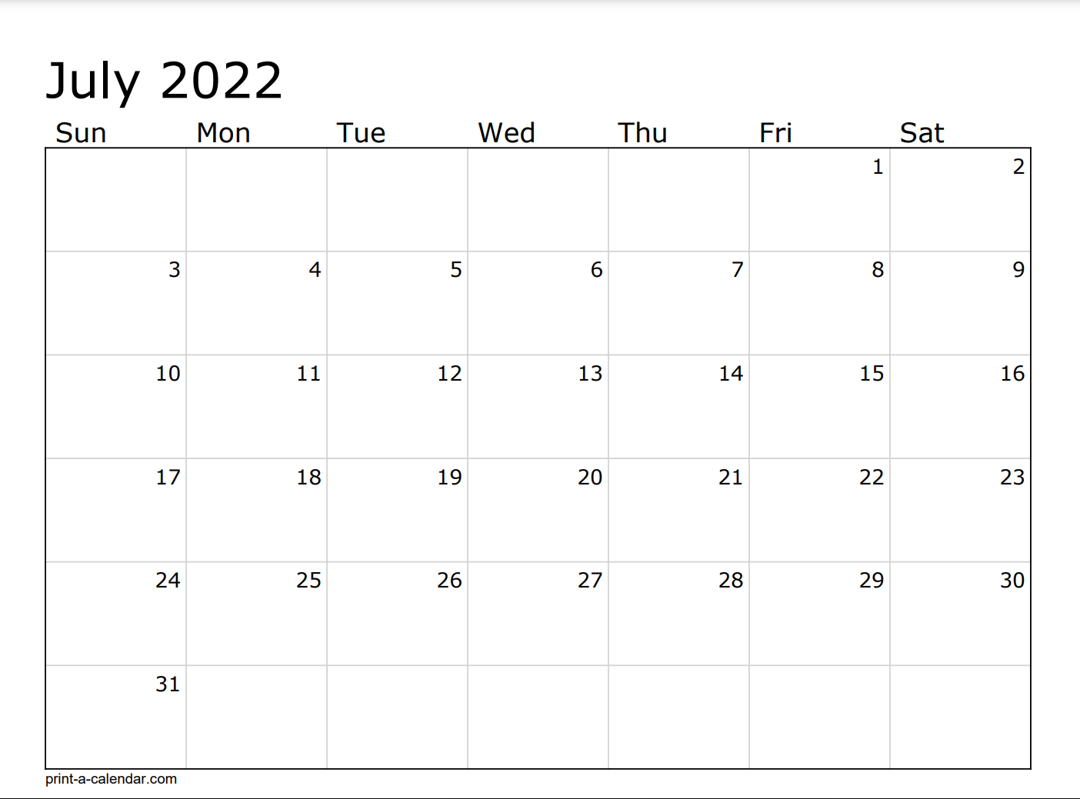
US Holiday
Sprint 103 - 6
Sprint 104 – 7 – ½ Testing

Slide 70
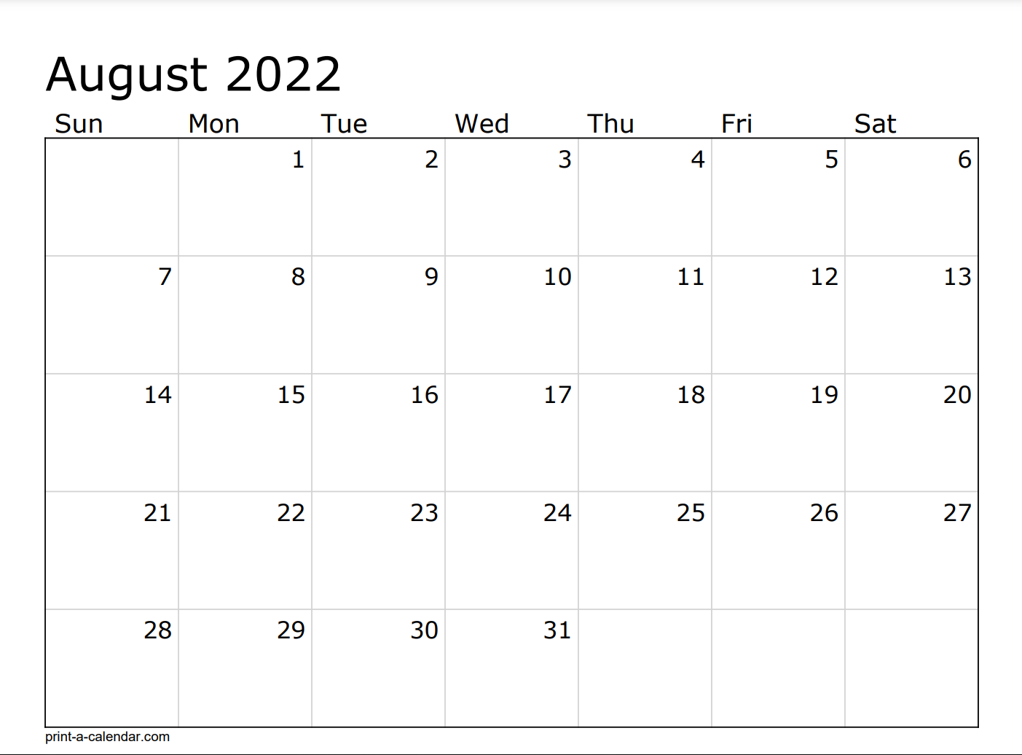
AO Code Freeze
Testing (Regression, China, Backward, Integration, Performance) and Critical Defects
USI – Holiday
Testing (Regression, China, Backward, Integration, Performance) and Critical Defects
USI – Holiday
Sprint 105 - Testing
Final UAT
Testing (Regression, China, Backward, Integration, Performance) and Critical Defects
Testing (Regression, China, Backward, Integration, Performance) and Critical Defects
USI – Holiday

Slide 71
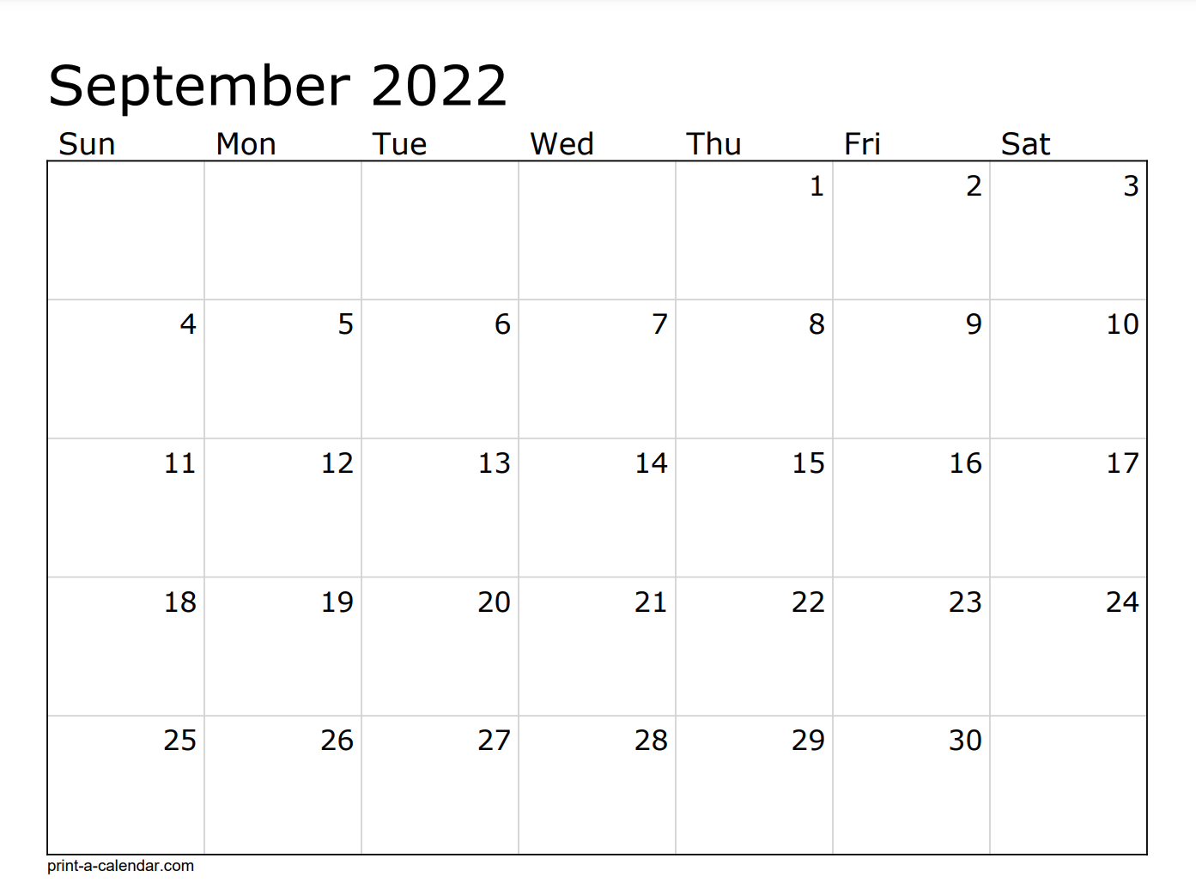

Test Complete
Testing (Regression, China, Backward, Integration, Performance) and Critical Defects
Ad Hoc/Buffer
AO Gold Code
US Holiday
Sprint 106 - IP
AO Deploy
Technical Deployment
PI Planning - 9
AO Start
Sprint 107 - 1

Slide 72
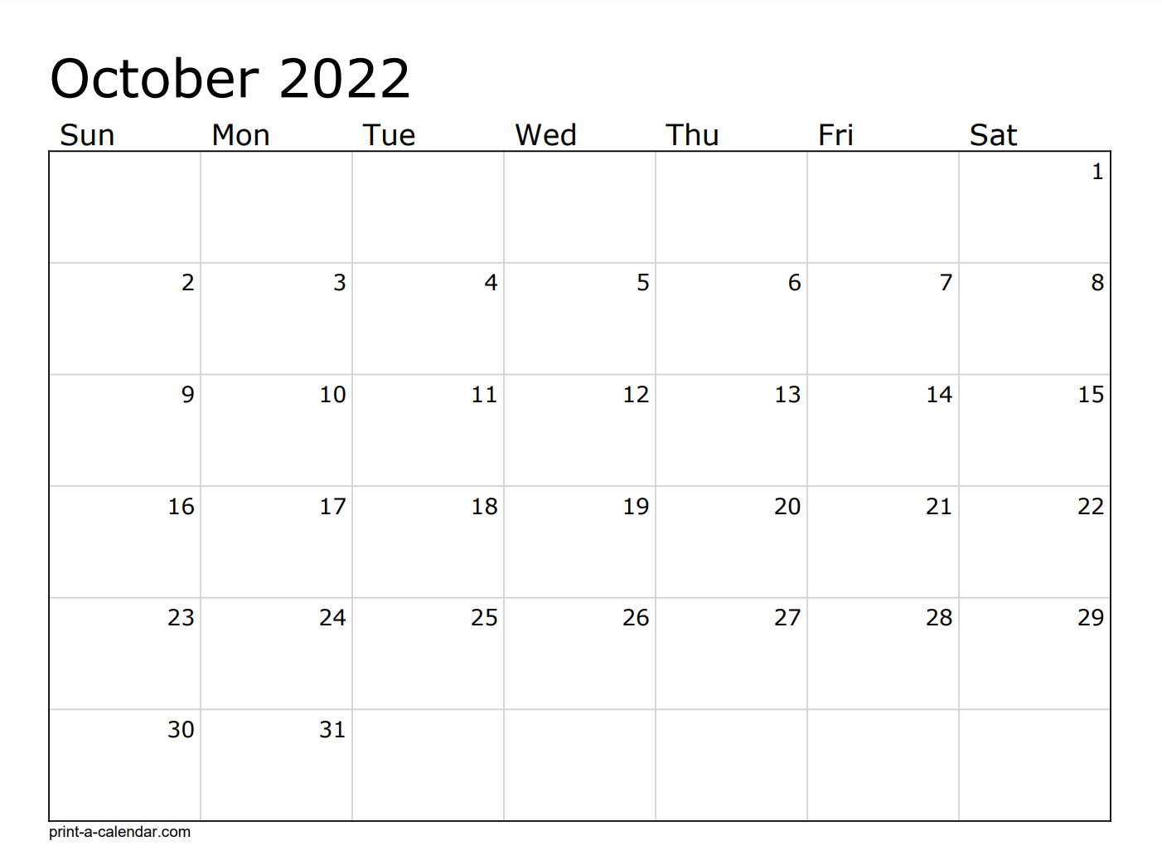
USI – Holiday
Sprint 108 - 2
USI – Holiday

Slide 73
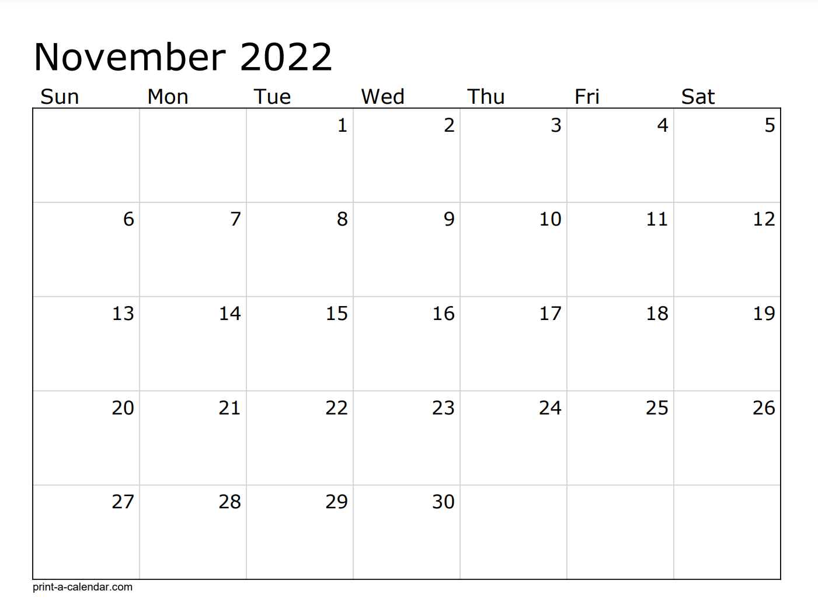
Sprint 109 - 3
US Holiday
Sprint 110 – 4 -1/2 Testing

Slide 74
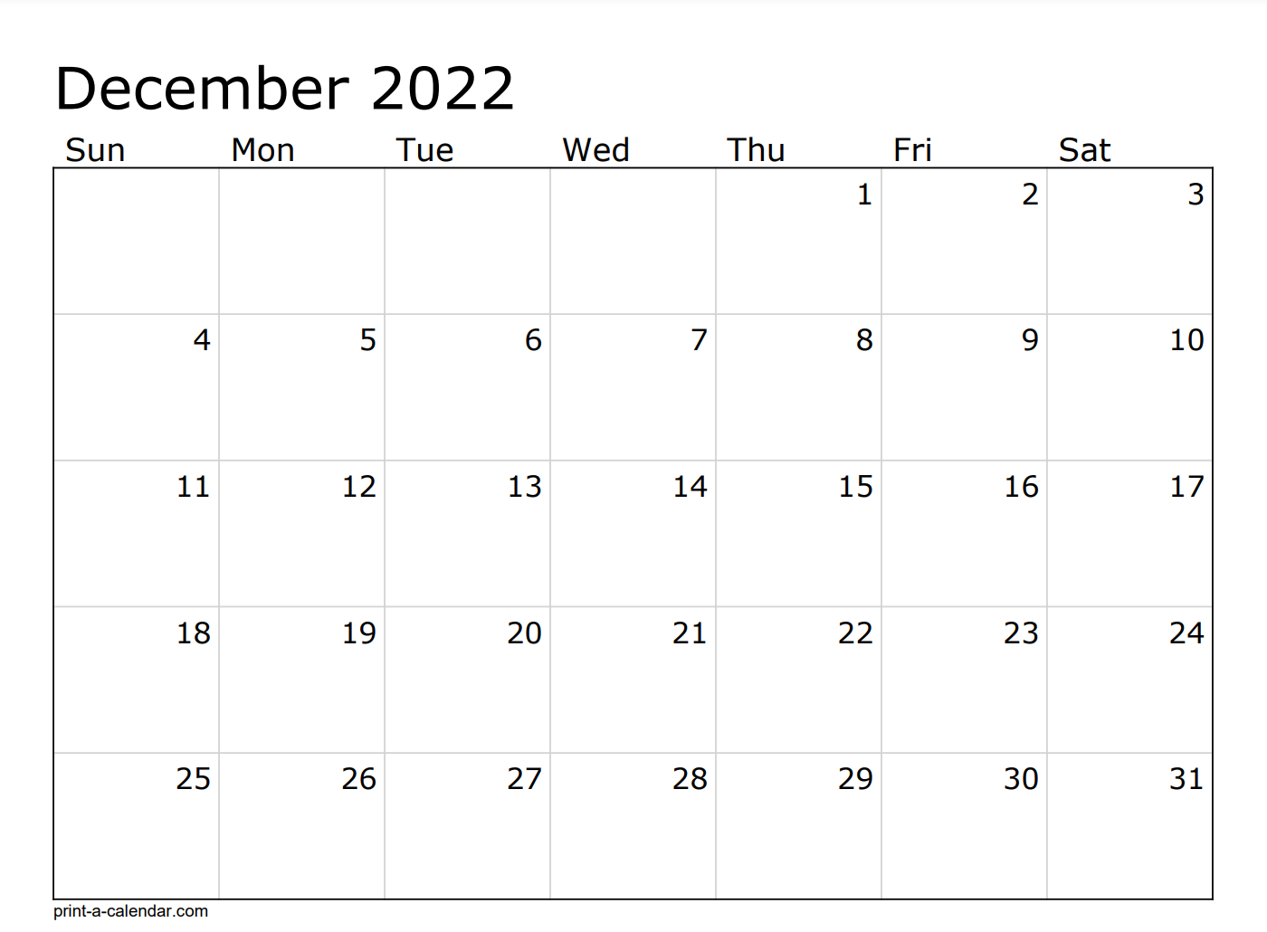
Mid Release Testing
AO Code Freeze
Mid Release Testing
Sprint 111 - 5
US/USI - Holiday

Slide 75
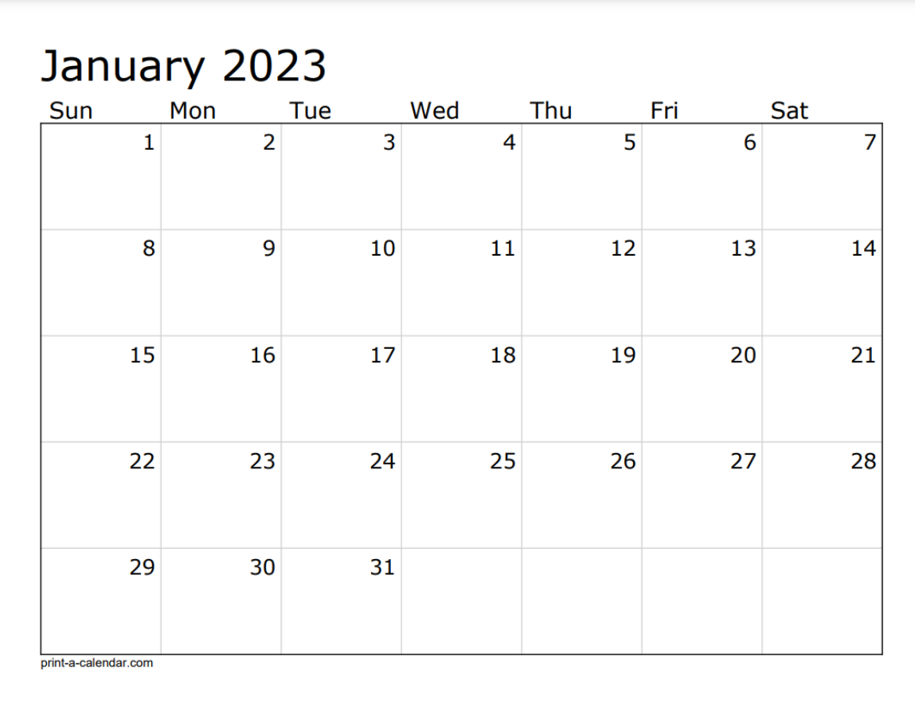
Sprint 112 - 6
US Holiday

Slide 76
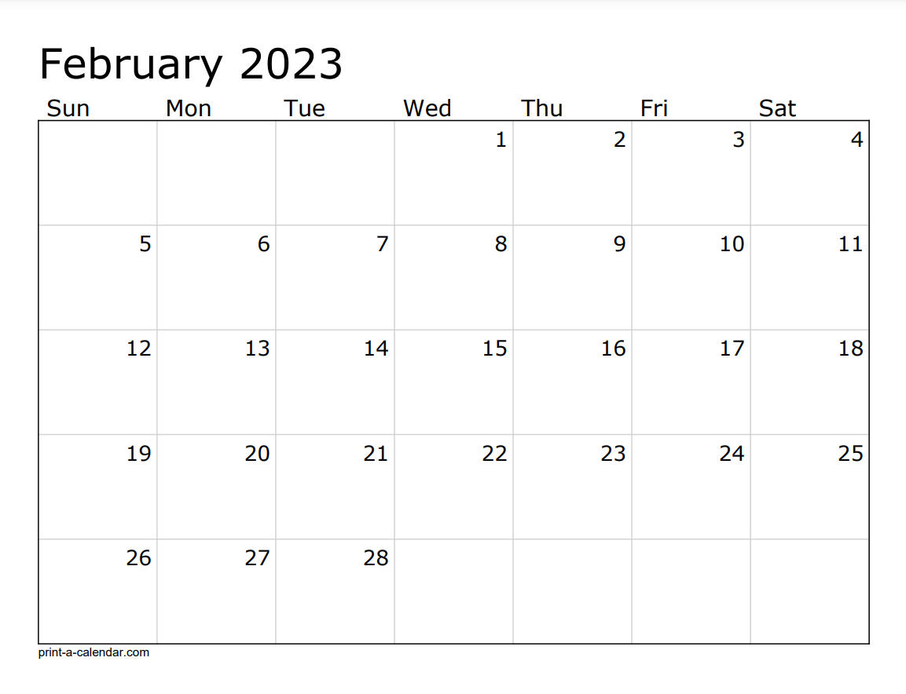
Sprint 113 –7-½- Testing
AO Code Freeze
Testing (Regression, China, Backward, Integration, Performance) and Critical Defects
Testing (Regression, China, Backward, Integration, Performance) and Critical Defects
Sprint 114 - Testing
Testing (Regression, China, Backward, Integration, Performance) and Critical Defects

Slide 77
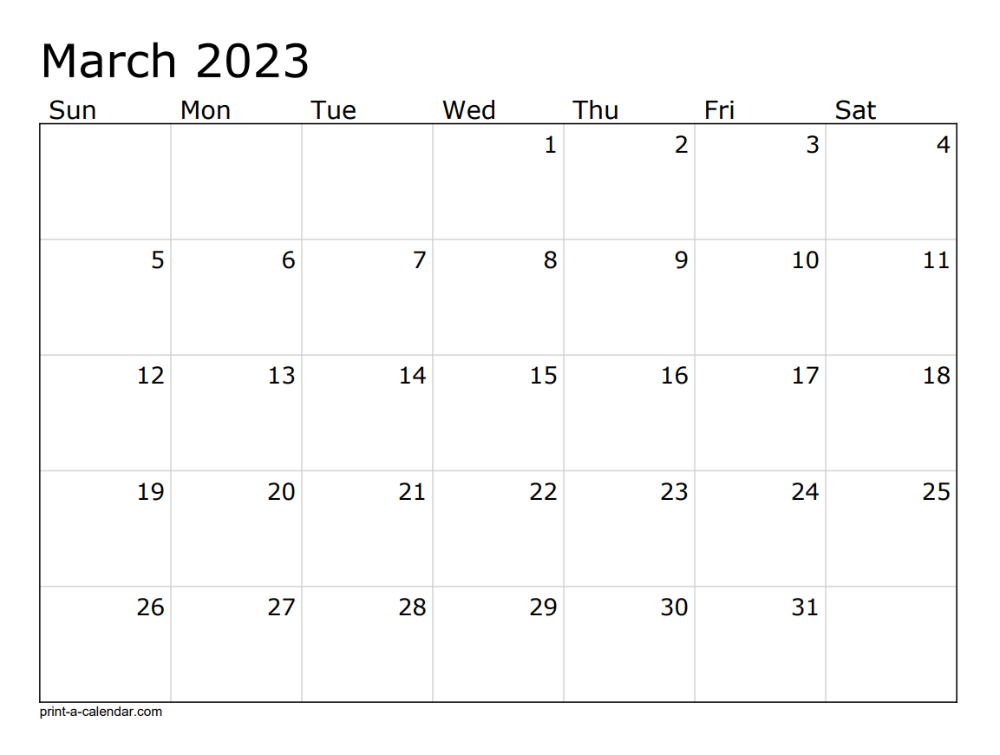
Testing (Regression, China, Backward, Integration, Performance) and Critical Defects
Test Complete
Testing (Regression, China, Backward, Integration, Performance) and Critical Defects
Final UAT
Ad Hoc/Buffer
Sprint 115 - IP
AO Gold Code
Technical Deployment
AO Deploy
PI Planning – 10

Slide 78
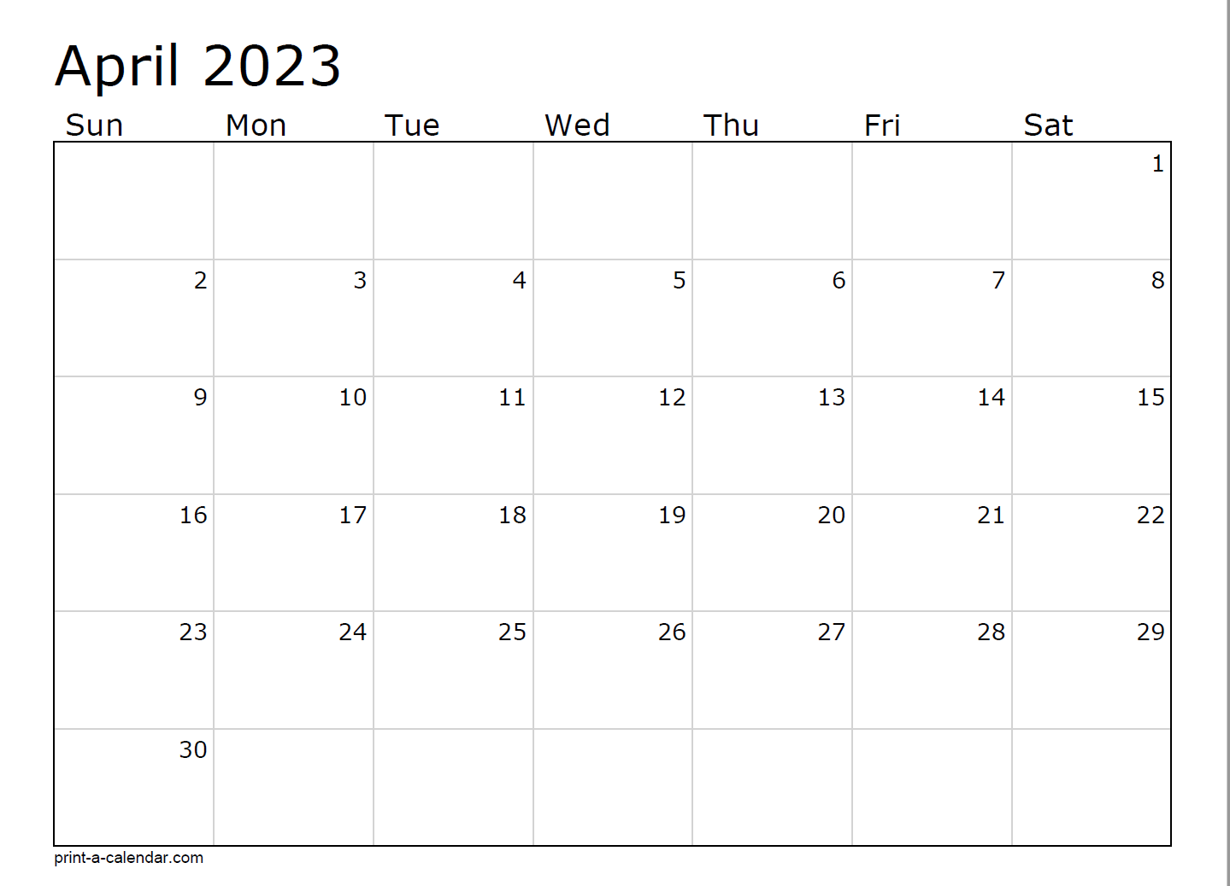
AO Start
Sprint 116 - 1
Sprint 115 - IP

Slide 79
Audit Online – Team Structure
CPO: Arnold Berkhout
Technical Owner: Shabab Hussain (US), Suresh Thandalay (USI)
DL: Mythili Pisolkar
Product Manager: Lauren Jackman
Jaguars
Kanini
Autocrats
Technokats
Dharini Jivrajani (SM)
Mamilla Bhavita (PO)
Zois Bouikidis (PO)
Romero, Tatiana (Dev)
Jyothi Thammisetty (Dev)
Prasad Sawant (Dev)
Junedh Malek (Dev)
Jack Williams(Dev)
Daniel Magee(Dev)
Rachel Strupinsky (SDET)
Geedha Suruliraj (SDET)
Navya Putumbaka (SDET)
Srijana T(SDET)
Dharini Jivrajani (SM)
Mamilla Bhavita (PO)
Zois Bouikidis (PO)
Kanini (PO)
TBD (Dev)
TBD (Dev)
TBD (Dev)
TBD (Dev)
TBD (SDET)
TBD (SDET)
Padmini Swarna (SM)
Garugu Ramana (PO)
John Kuriakose (PO)
Open Position (Dev Lead)
Arpit Chandak (Dev)
Mukharjee Chippa (Dev)
Dilip kumar (Dev)
Vikash(Dev)
Antara Chansakar(Dev)
Mounika(Dev)
Aditya(Dev)
Srinivas Gudur (QA Lead)
Keerthi Shirisha (SDET)
Subba Rao Peram (SDET)
Samikshya Mishra(SDET)
Padmini Swarna(SM)
Manohar Pichike (PO)
Bornita Ganguli (PO)
Sathish Tatikonda(Dev Lead)
Sahithi, Kesarapu (Dev)
Vaisakh Chandran (Dev)
Srinivas Gadiboyana (Dev)
Vyshnavi Yerragunta(Dev)
Nitin Medapati(Dev)
Debjoti(Dev)
Garugu Ramana (QA Lead)
Anil Thota (SDET)
Swarna Padmini(SDET)
Vasu Shukla (SDET)
Open Position(SDET)
Technical Architects:, Janine Kutas-Hille, Jignesh Patel, Anubha Bhargava, Waseem Nader
Dev Ops: Vanessa Minik, Naveen Jaini

Slide 80
Diagnostics – Team Structure
CPO: Ben Hamilton
DL: Sowmya Kandula
Product Manager: Andrew Thilakan
Data Dynamics
Ezra Hermon (PO / SM)
Koyal Mitra (PO)
Ramesh Kumar Avva (Dev)
Nishanth (Dev)
Appani Mallikarjun (Dev)
Avinash Longadge (Dev)
Shravan Kumar R Sedala (SDET)
Chintala Chaitanya (SDET)
Rajasekhar Venkata (SDET)
Business Deployment: Leah Pais
Dev Ops: Rahul Thakur Singh, Navneeth Kaur

Slide 81
Diagnostics Extended Reporting – Team Structure
CPO: Ben Hamilton
DL: Sravanthi Jonnalagadda, Sowmya Kandula
Product Manager: Andrew / Spencer / Jen Kelly
Data Warriors
Data Routers{Kanini}
Abdullah Girach (PO/SM)
Soma Kundu (Dev)
Sandeep Marru (Dev Lead)
Himanshu Gautam (Dev)
Gowtham Reddy Guntaka (Dev)
Praveen Vitta(Dev)
Jinesh Shakya(Dev)
Open Position (Dev)
Open Position (Dev)
Anjaneyulu Chinni (SDET)
Guddadgi, Sharanabasappa (SDET)
Ankit Jain (SDET)
Bhanu Prakash (SDET)
TBD (PO)
Krishnamoorthy, Ramesh (Lead)
Balasubramanian, Amuthasakaran(Dev)
Sampath, Sridhar(Dev)
Selvaraj, Selva Sajin(Dev)
Selvaraj, Sriramsankar (Dev)
Selvaraj, Vasantha Kumar(Dev)
Sharma, Navin(Dev)
Umapathy, Chethan Kumar(Dev)
Jani, Ahamed Ali (QA)
Pesala, Nagamani (QA)
Janani Rajan(QA)
Technical Architect: Ashok Thuremella
Business Deployment: Leah Pais
Dev Ops: Sravya Ramana; Srinath Reddy

Slide 82
EMS – Team Structure
CPO: Arnold Berkhout
Engagement Lead: Suresh Thandalay
DL: Vijaya Rudraraju
Product Manager: Eduardo Alonso
Bahamas
Jamaica
Amigos
Rakesh Sharma Palla (PO)
Vanisree Venkatachalapathy (PO)
Jyothi Adusumilli(SM)
Vasu Gundipalli(Dev Lead)
Chandrika Bandi (DMG Lead)
Ramesh Palapati (Dev)
Nagesh Jammula (Dev)
Prathyusha Boyidi(DEV)
Lallu Prasad(Dev)
Manoj Aluvala (DMG)
Parul Priya(DMG)
Jyothi Adusumilli(QA Lead)
Shravya Sunkavalli (SDET)
VijayaLakshmi(QA)
Rakesh Sharma Palla (PO)
Usha Muppana (PO)
Jyothi Adusumilli(SM)
Venkata Kunduru (Dev)
Ashok G(Dev)
Aditya Patidar
Krishnamurthy Gonnuru(Dev)
Open(Dev)
Jyothi Adusumilli(QA Lead)
Siva Priya (SDET)
Anusha Ramisetty(SDET)
Debbie Eng(PO)
Rakesh Sharma Palla (PO)
Priyanka Bharade (Dev Lead)
Swami Dodla (Dev)
Madhu Kunta(Dev)
Ajay Srivastava(Dev)
Priyanka Nanduri (SDET)
Shravani Manati (QA)
Technical Architects: Manish S, Open*
Dev Ops: Santhosh Kondreddy , Navneeth Kaur

Slide 83
CMS – Team Structure
CPO: Arnold Berkhout
Engagement Lead: Suresh Thandalay
DL: Prathap Ramados
Product Manager: Swetha Majjiga
Content Fosters
Sowjanya Chinda (SM)
Kavya Gajji (PO)
Sonal Singh (PO)
Fatima Saba (Dev)
Siva Sankar Vurimi (Dev)
Nagaswati Chanda (SDET)
Technical Architects: Prathap Ramados
Dev Ops: , Sadaiah Gundati

Slide 84
AQMM – Team Structure
CPO: Michelle Keyes, Michel Guertin
Engagement Lead: Suresh Thandalay, Shabab Hussain
Product Manager: Rose Zhong
Falcon Heavy
Saturn V
Krishnendu Mukherjee (PO)
Kalyan Chakravarthi (SM)
Vibha Uniyal (BSA)
Open position (Dev CL4)
Rohit Rai (Dev)
Vandana Mishra(Dev)
Ayushi Gupta (Dev)
Neha Aggarwal (Dev)
Mantha Yashasvi (Dev)
Sanjay Kumar (Dev)
Vamshi Akula (Dev)
Irfan Zaidi (Dev)
Kesava Vemula (SDET )
Rekha Devi Chinni (SDET)
Vijay Kumar Kurre (SDET)
Vajravel Bhoopalam (PO)
Sunil Verma (Technical Architect)
Lakshmi Dhruvarao (SM)
Gopinath G (Dev)
Mahesh Pattar (Dev)
Vijay Revtangav (Dev)
Tejasimha (Dev)
ChetanRaj (Dev)
Sachin Rai (SDET)
Gowthama Nagaraja (SDET)
Prajakta Jhadav (SDET)
TDM & Technical Architect : Karthik Chandupatla
Dev Ops: Santhosh Kondreddy, Devi Dasari

Slide 85
DevOps – Team Structure
DL: Anubha Bhargava & Navneeth Kaur
Cloud Eagles
AO/AQMM/ER
DAD/CMS/EMS/TL/ACTT Support
Cloud Production Support (AO/AQMM/ER)
Dharini J (SM)
Anubha Bhargava(Lead)
Naveen Chandra Jaini
Vanessa Minik
Santhosh Kondreddy
Nitin Keswani
Sravya Ramana
Srinath Reddy
Devi Dasari
Navneeth Kaur (PO)
Santhosh Kondreddy
Devi Dasari
Rahul Thakur
Navneeth Kaur
Sadaiah Gundati
Anubha Bhargava (PO)
German(EMA)
Azrin (APA)
AME Devops
Global DevOps Lead: Mark Strolle | Portfolio Lead: Pete Tryon

Slide 86
US – Lunch Break | 75 Min
USI - Break for the day

